Slide 1

Diagnosis of Personality Disorders: A Historical Perspective
Congres Zorgstandaard Personality Disorders
Haarlem, The Netherlands
November 27, 2018
John M. Oldham, M.D.
Interim Chief of Staff, The Menninger Clinic
Distinguished Emeritus Professor
Menninger Department of Psychiatry and Behavioral Sciences
Baylor College of Medicine, Houston, Texas
Past President, American Psychiatric Association
Advancing treatment. Transforming lives.

Slide 2
Hippocrates Classification
Element | Humor | Type | Style
Air | Blood | Sanguine | Hopeful Enthusiastic Optimistic
Earth | Black Bile | Melancholic | Sad
Fire | Yellow Bile | Choleric | Irascible Irritable
Water | Phlegm | Phlegmatic | Apathetic Slow

Slide 3
European Pioneers of Descriptive Psychiatry
Eugen Bleuler (1857-1939)--Swiss
Emil Kraepelin (1856-1926)--German
Ernst Kretschmer(1888-1964)-German
Kurt Schneider (1887-1967)--German

Slide 4
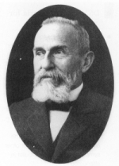
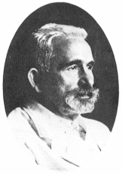
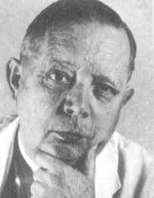
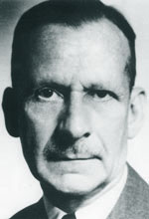
Eugen Bleuler
Emil Kraepelin
Ernst Kretschmer
Kurt Schneider

Slide 5
Personality Types or Temperaments
(Bleuler, Kraepelin, Kretschmer)
Precursors, or less extreme forms of psychotic conditions. For example,
  Aesthenic
  Autistic
  Schizoid
  Cyclothymic
  Cycloid

Slide 6
Spectrum Model
Conceptually similar to dimensional models of personality traits and disorders

Slide 7
Psychopathic Personalities
(Schneider)
Separate disorders, co-occurring with other psychiatric disorders
Similar to current DSM categorical model

Slide 8
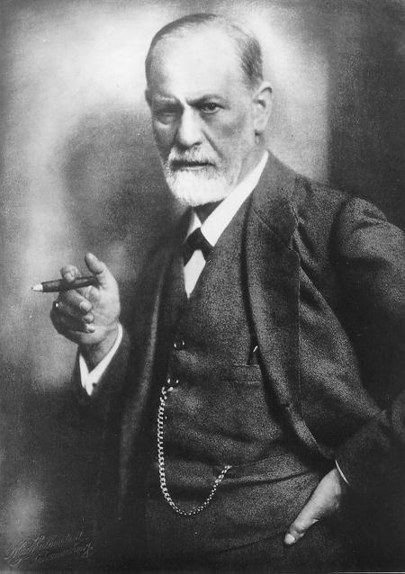
Sigmund Freud
1856-1939

Slide 9
Freud
Character disorders
  “Pre-Oedipal”
  Ego-syntonic
  Externalizing
  Poorly motivated to change

Slide 10
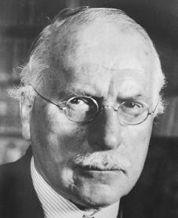
Carl G. Jung
(1875-1961)

Slide 11
Jung
  Extraversion
  Introversion

Slide 12
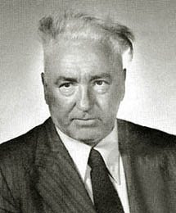
Wilhelm Reich
(1897-1957)

Slide 13
Reich
  Personality as defensive
  “Character armor”

Slide 14
The APA DSM System

Slide 15
Technical Bulletin 203 (1943)
  Developed by United States War Department
  Need for standardized diagnosis in context of World War II
  Psychoanalytically-oriented system of terminology for classifying mental illness precipitated by stress

Slide 16
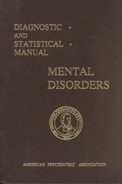
DSM-I (1952)

Slide 17
DSM-I
Personality Pattern Disturbances
The most entrenched, unlikely to change, even with treatment
  Inadequate
  Schizoid
  Cyclothymic
  Paranoid

Slide 18
DSM-I
Personality Trait Disturbances
  Least pervasive and disabling
  Absent stress, function ok
  With stress, deterioration in functioning
  Variably motivated and amenable to treatment
    Emotionally unstable
    Passive-aggressive
    Compulsive

Slide 19
DSM-I
Sociopathic Personality Disturbances
  Types of social deviance
    Antisocial reaction
    Dyssocial reaction
    Sexual deviation
    Addiction

Slide 20
DSM-II (1968)

Slide 21
DSM-II (1968)
  Coincided with ICD-II (1968)
  Moved away from theory, toward constellations of personality that were observable, measurable, and enduring

Slide 22
DSM-II (continued)
  Earlier view that patients with PDs did not experience emotional distress was discarded
  DSM-I subcategories were discarded
  One new PD, Aesthenic PD, added

Slide 23
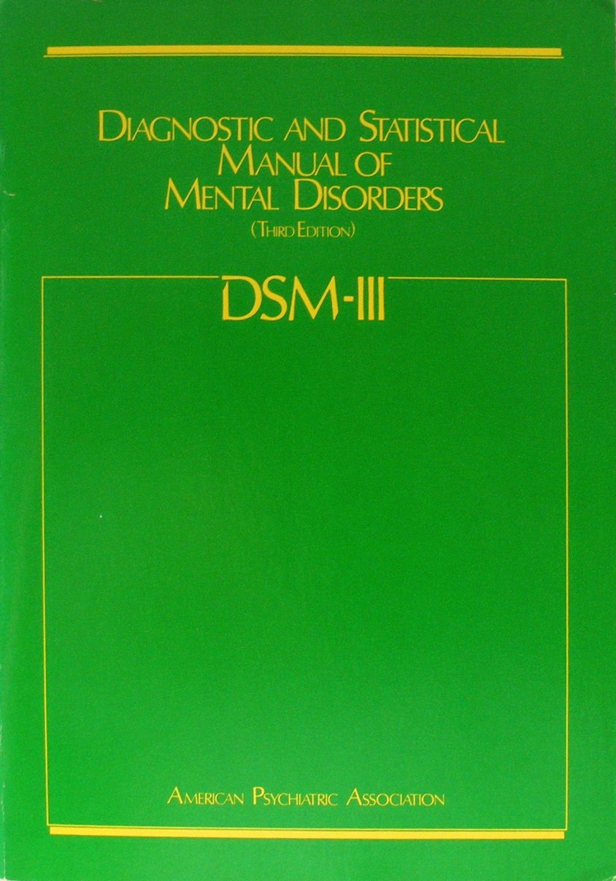
DSM-III (1980)

Slide 24
DSM-III (1980)
  Introduced multiaxial system
  Axis I = episodic, “biological” disorders characterized by exacerbations and remissions
  Axis II = personality disorders + specific developmental disorders
    MR = “biological” etiology
    PDs = “psychological” etiology

Slide 25
DSM-III (continued)
  Inadequate PD and Aesthenic PD discontinued
  Explosive PD and Cyclothymic PD → Axis I
  Schizoid PD → Schizoid, Schizotypal, and Avoidant PDs
  Borderline PD and Narcissistic PD added

Slide 26
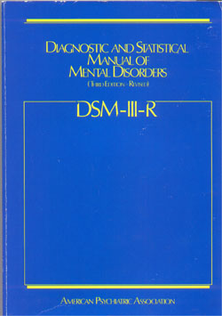
DSM-III-R (1987)

Slide 27
DSM-III-R (1987)
  Input from researchers and clinicians
  Effort to minimize reliance on theory
  Yet, for some disorders, “particularly the Personality Disorders, the criteria require much more inference on the part of the observer”
  Criteria sets made uniformly polythetic

Slide 28
DSM-III-R (continued)
  Appendix = “Proposed Diagnostic Categories Needing Further Study”
  Included:
    Self-defeating PD
    Sadistic PD
  Dimensional cluster system introduced

Slide 29
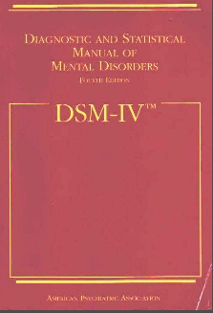
DSM-IV (1994)

Slide 30
DSM-IV (1994)
  Introduced a general set of diagnostic criteria for any PD

Slide 31
DSM-IV Definition of
Personality Disorder
An enduring pattern of inner experience and behavior that deviates markedly from the expectations of the individual’s culture. This pattern is manifested in two (or more) of the following areas:
  Cognition (i.e., ways of perceiving and interpreting self, other people, and events)
  Affectivity (i.e., the range, intensity, ability, appropriateness of emotional response)
  Interpersonal functioning
  Impulse control

Slide 32
DSM-IV Definition of
Personality Disorder (continued)
The enduring pattern is inflexible and pervasive across a broad range of personal and social situations.

Slide 33
DSM-IV Definition of
Personality Disorder (continued)
The enduring pattern leads to clinically significant distress or impairment in social, occupational, or other important areas of functioning.

Slide 34
DSM-IV Definition of
Personality Disorder (continued)
The pattern is stable and of long duration and its onset can be traced back at least to adolescence or early adulthood.

Slide 35
DSM-IV Definition of
Personality Disorder (continued)
The enduring pattern is not better accounted for as a manifestation or consequence of another mental disorder.

Slide 36
DSM-IV Definition of
Personality Disorder (continued)
The enduring pattern is not due to the direct physiological effects of a substance (e.g., a drug of abuse, a medication) or a general medical condition (e.g., head trauma).

Slide 37
DSM-IV (continued)
  Dropped Self-defeating PD and Sadistic PD
  Moved Passive-aggressive PD to Appendix
  Added Depressive PD to Appendix

Slide 38
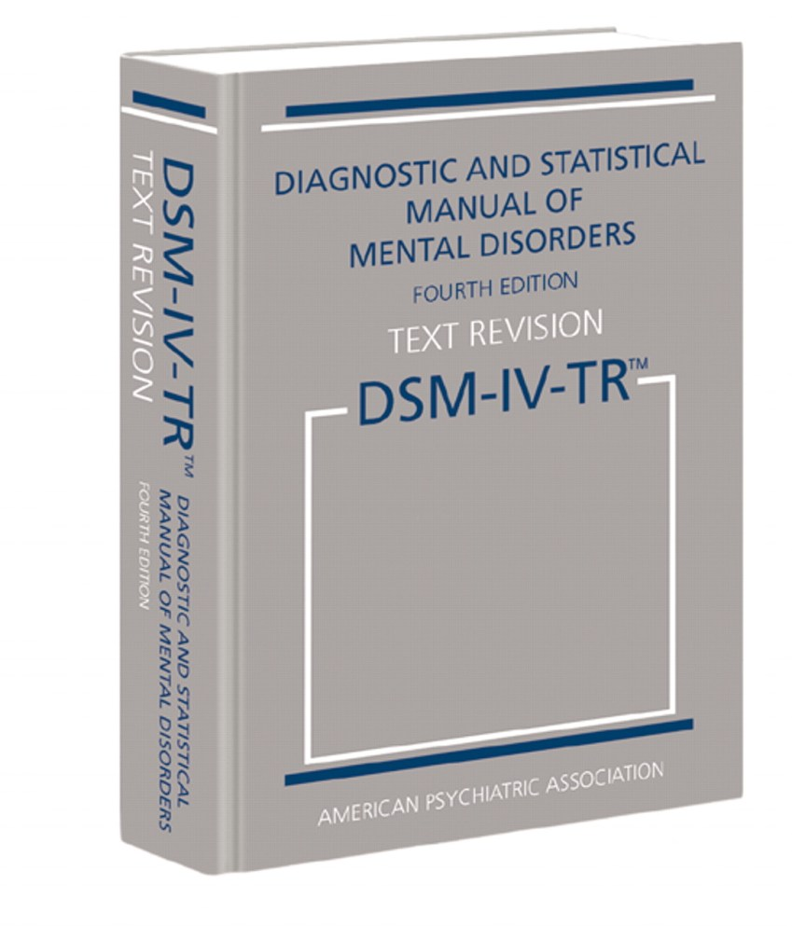
DSM-IV-TR (2000)

Slide 39
DSM-IV-TR (2000)
  No changes from DSM-IV in diagnostic terms or criteria for Axis II
  Only minimal revisions in text material for Axis II

Slide 41
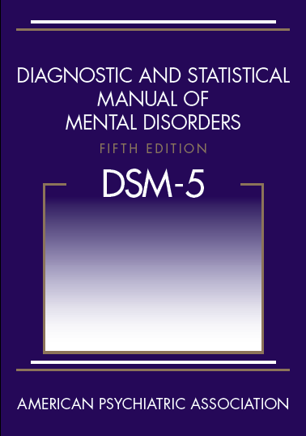
DSM-5 (2013)

Slide 42
DSM-5______________
•Axis I / Axis II – Discontinued
•Personality Disorders in Section II
(unchanged from DSM-IV)
•Personality Disorders in Section III
(Alternative Model for DSM-5 Personality Disorders [AMPD])

Slide 43
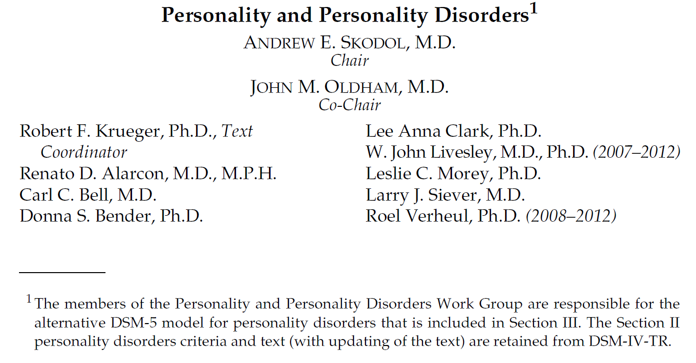

Slide 44
AMPD General Criteria for Personality Disorder
(DSM-5, Section III)
The essential features of Personality Disorder are:
Moderate or greater impairment in personality (self / interpersonal) functioning AND
One or more pathological personality traits

Slide 45
Criterion A
(Level of Impairment in Personality Functioning)
Moderate or greater impairment in personality (self/interpersonal) functioning, manifest by characteristic difficulties in two or more of the following four areas:
Identity
Self-direction
Empathy
Intimacy

Slide 46
Guidance in estimating “moderate or greater impairment”
Level of Personality Functioning Scale
0 - Little or No Impairment
1 - Some Impairment
2 - Moderate Impairment
3 - Severe Impairment
4 - Extreme Impairment

Slide 47
Criterion B
(Patterns of Pathological Personality Traits)
Trait Domains
Negative Affectivity
Detachment
Antagonism
Disinhibition
Psychoticism

Slide 48
DSM-5 GCPD (continued)
The impairments in personality functioning and personality trait expression are relatively inflexible and pervasive across a broad range of personal and social situations.

Slide 49
DSM-5 GCPD (continued)
The impairments in personality functioning and the individual’s personality trait expression are relatively stable across time with onsets that can be traced back to at least adolescence or early adulthood.

Slide 50
DSM-5 GCPD (continued)
The impairments in personality functioning and the individual’s personality trait expression are not better explained by another mental disorder.

Slide 51
DSM-5 GCPD (continued)
The impairments in personality functioning and the individual’s personality trait expression are not solely attributable to the physiological effects of a substance or another medical condition (e.g., severe head trauma).

Slide 52
DSM-5 GCPD (continued)
The impairments in personality functioning and the individual’s personality trait expression are not better understood as normal for an individual’s developmental stage or socio-cultural environment.

Slide 53
Personality Disorders
Antisocial
Avoidant
Borderline
Narcissistic
Obsessive-Compulsive
Schizotypal
PD – Trait Specified

Slide 54
Clinician Assessment of DSM-5 Personality Disorders
Moderate or Greater Impairment in Personality Functioning
Personality Disorder(s)
PD – Trait-Specified
or
Meets All Other General PD Criteria
PD Diagnosis Confirmed

Slide 55
Morey et al. WG Study
A recent empirical study involving 334 clinicians found that in 14 of 18 comparisons, DSM-5 is perceived as more clinically useful than DSM-IV with respect to:
Ease of use
Communication of clinical information to other
professionals
Communication of clinical information to
patients
Comprehensiveness in describing pathology
Treatment planning
Morey, Skodol, Oldham, Journal of Abnormal Psychology, 2014

Slide 56
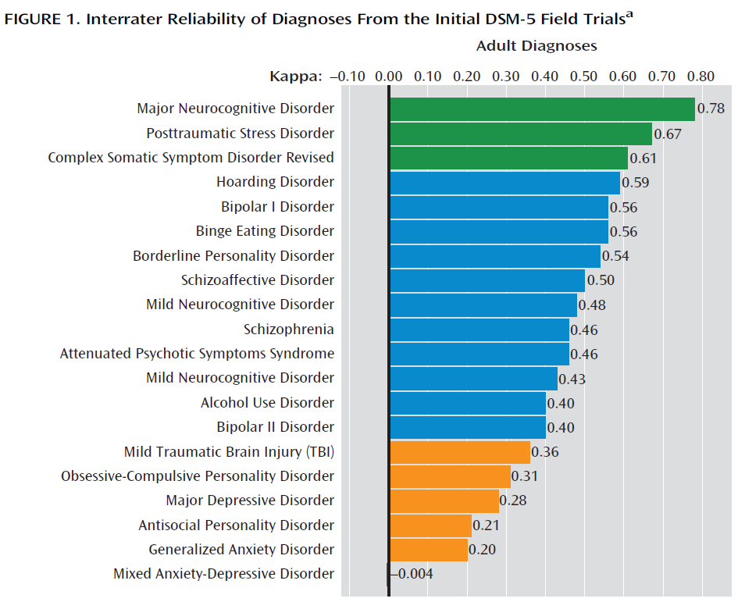

Freedman et al., AJP January 2013

Slide 57
Field Trials
“Borderline personality disorder* now emerges as a major diagnosis in its own right with good diagnostic reliability.”
*[as defined by the Alternative Model]
- Freedman et al., American Journal of Psychiatry, 2013

Slide 58
ICD-11 PD Proposal
Single Diagnostic Category: Personality Disorder
Definition: A pervasive disturbance in how an individual experiences and thinks about the self, others, and the world, manifested in maladaptive patterns of cognition, emotional experience, emotional expression, and behavior.
Tyrer et al., Lancet, 2015

Slide 59
ICD-11 PD Proposal (continued)
Levels of severity:
Mild
Moderate
Severe
Tyrer et al., Lancet, 2015

Slide 60
ICD-11 PD Proposal (continued)
Domain traits:
Negative affective features
Dissocial features
Features of disinhibition
Anankastic features
Features of detachment
Tyrer et al., Lancet, 2015

Slide 61
DSM-5, Section III | ICD-11
Negative affectivity | Negative affectivity domain
Detachment | Detachment domain
Antagonism | Dissocial domain
Disinhibition | Disinhibited domain
Psychoticism | (Schizotypal disorder)
(Trait facets of restricted affectivity, rigid perfectionism, perseveration) | Anankastic domain
Adapted from Newton-Howes et al., Lancet, 2015

Slide 62
A current dimensional model of personality, from adaptive styles to disabling disorders

Slide 63
Armand W. Loranger, Virginia Lehmann Susman, John M. Oldham, and L. Mark Russakoff (1987). The Personality Disorder Examination: A Preliminary Report. Journal of Personality Disorders: Vol. 1, No. 1, pp. 1-13.
https://doi.org/10.1521/pedi.1987.1.1.1
The Personality Disorder Examination: A Preliminary Report
Armand W. Loranger, PhD; Virginia Lehmann Susman, MD; John M. Oldham, MD; L. Mark Russakoff, M

Slide 64


Slide 65
The Blood Pressure Model
Blood pressure [personality] is an essential component of any living human being.
But too much, or too little, of a necessary thing can become a problem.

Slide 66
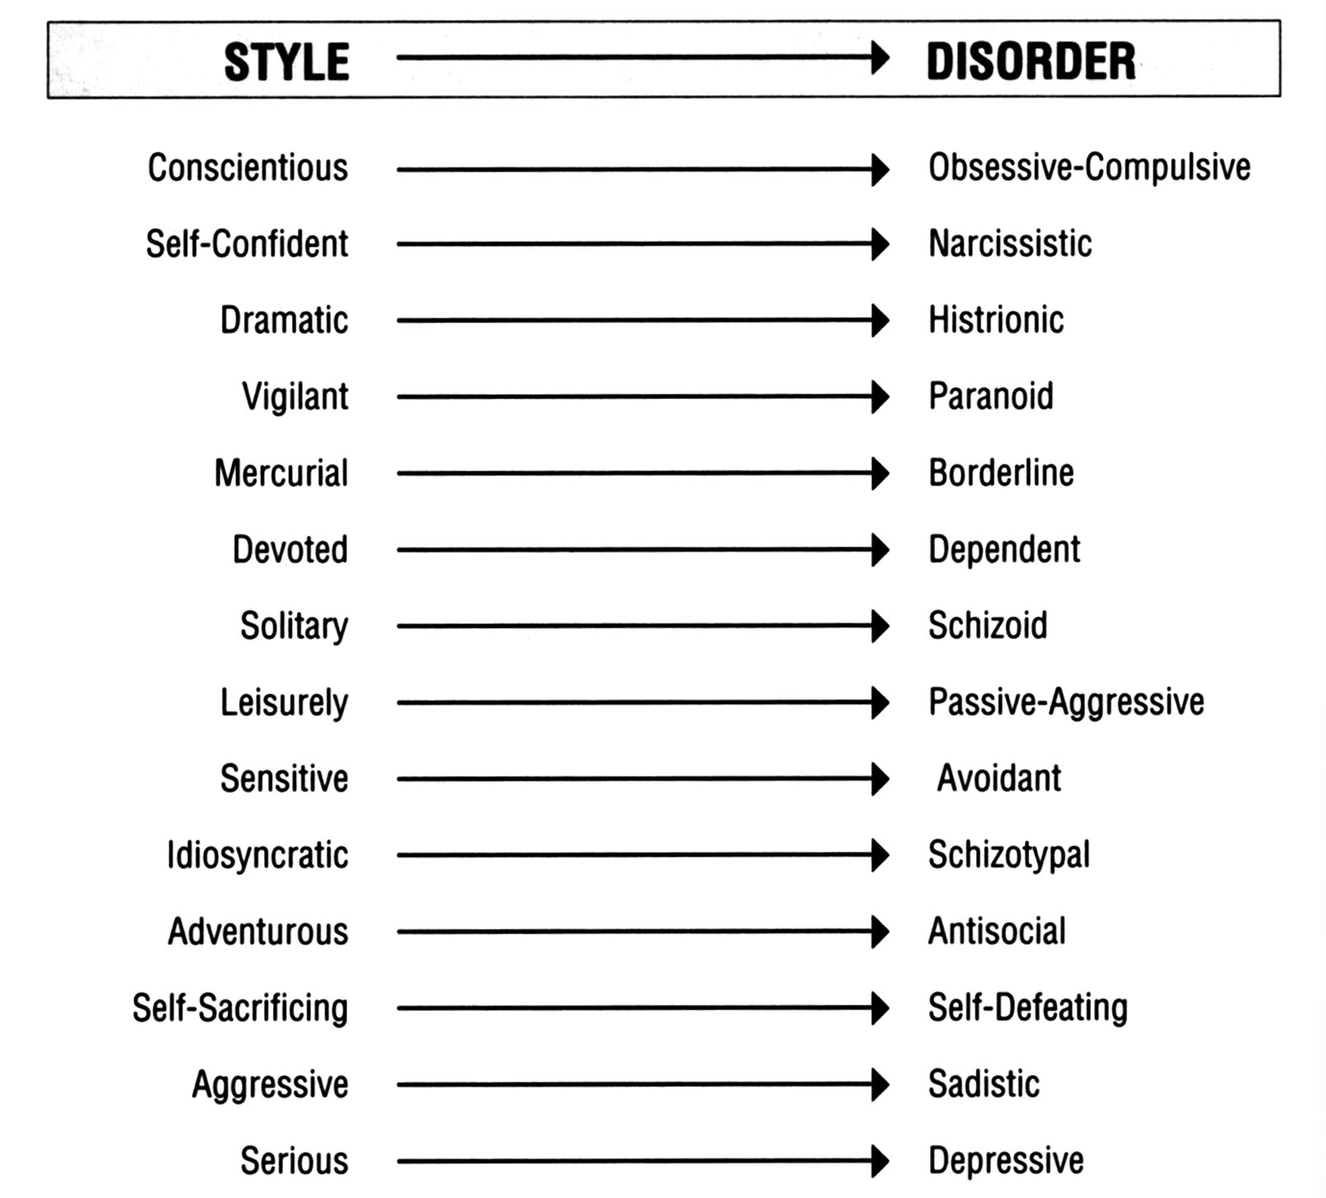
The Personality Style-Personality
Disorder Continuum

Slide 68
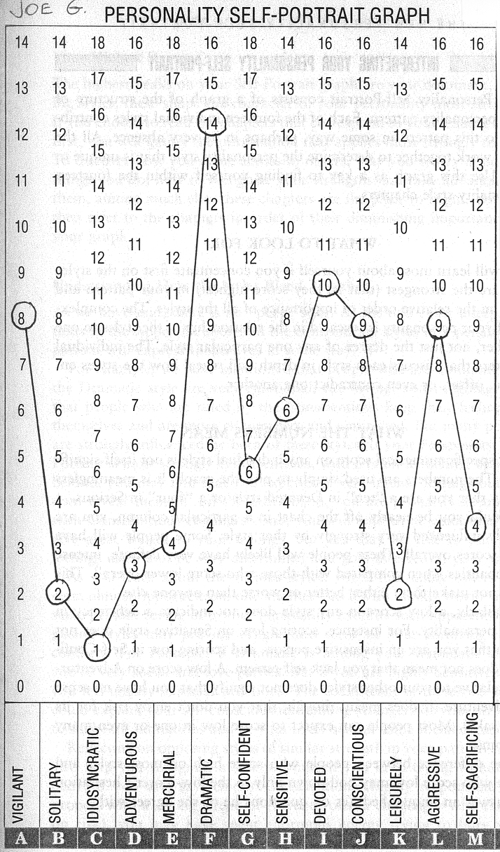

Slide 69
www.npsp25.com
Questionnaire configured for computer scoring, 2015
Posted on a website, no marketing, free use
Within >2 years, over 12,000 people worldwide took test
New website developed (current, above)
Provides Personality Self-Portrait Graph, an Interpretation Guide, and percentile scores comparing results with the International Sample

Slide 70
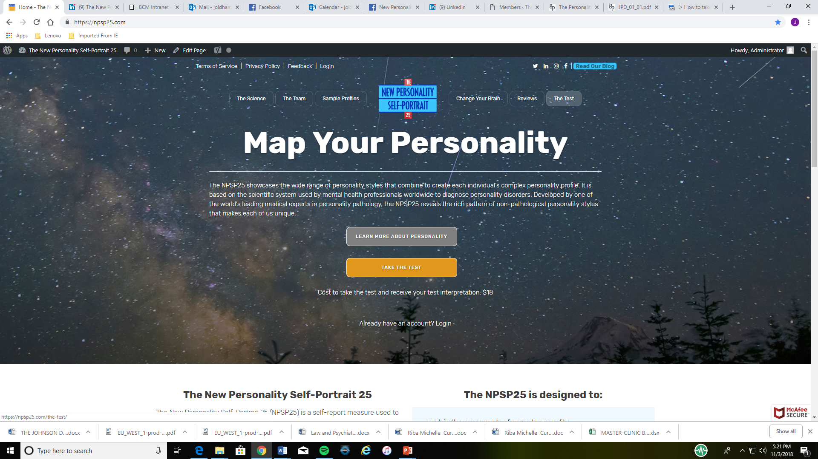

Slide 73


Slide 74
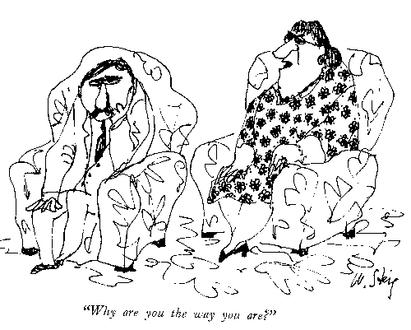

Slide 75
Thank you for your interest

