Slide 1





Borderline Personality Disorder in adolescents
Carla Sharp, Ph.D.
csharp2@uh.edu

Slide 2
Why should we care?

Slide 3
What should we target?

Slide 4
Why should we care?
Finding #1:
BPD onsets in adolescents
Finding #2
Adolescent BPD by and large looks like adult BPD
Finding #3:
Personality pathology is as stable in adolescence as adulthood, but associated with poorer longterm outcomes compared to internalizing and externalizing pathology
Finding #4:
Personality pathology is preceded by internalizing and externalizing disorders, but not the other way round
Finding #5:
Personality pathology remains comorbid with internalizing and externalizing pathology throughout development

Slide 5
What should we target?
Criterion A function

Slide 6
DSM-5 Section III Criterion A:
Level of Personality Functioning
Self
  Identity: Experience of oneself as unique with clear boundaries between self and others’ stability of self-esteem and accuracy of self-appraisal; capacity for, and ability to regulate, a range of emotional experience.
  Self-direction: Pursuit of coherent and meaningful short-term goals and life goals; utilization of constructive and prosocial internal standards of behavior; ability to self-reflect productively.
Interpersonal
  Empathy: Comprehension and appreciation of others’ experiences and motivations; tolerance of differing perspectives; understanding the effects of one’s own behavior on others.
  Intimacy: Depth and duration of connection with others; desire and capacity for closeness; mutuality of regard reflected in interpersonal behavior.

Slide 7
The core of personality pathology

Slide 8
DSM-5 Section II BPD
(DSM-IV BPD)
A pervasive pattern of instability of interpersonal relationships, self-image, and affects and marked impulsivity beginning by early adulthood and present in a variety of contexts as indicated by five (or more) of the following:
1) Frantic efforts to avoid real or imagined abandonment
2) A pattern of unstable and intense interpersonal relationships characterized by alternating between extremes of idealization and devaluation
3) Identity disturbance markedly and persistently unstable self-image or sense of self
4) Impulsivity in at least two areas that are potentially self-damaging (e.g. spending, sex, substance abuse, reckless driving, binge eating)
5) Recurrent suicidal behavior, gestures, or threats, or self-mutilating behavior
6) Affective instability due to a marked reactivity of mood (e.g. intense episodic dysphoria, irritability, or anxiety usually lasting a few hours and only rarely more than a few days)
7) Chronic feelings of emptiness
8) Inappropriate, intense anger or difficulty controlling anger (e.g.) frequent displays of temper, constant anger, recurrent physical fights)
9) Transient, stress-related paranoid ideation or severe dissociative symptoms

Slide 9
ICD-11 severity criterion*
If general guidelines for a PD are met, a level of severity is provided and is based upon the following:
  A) Degree and pervasiveness of self-dysfunction, as in identity, self-worth, and self-regulation.
  B) Degree and pervasiveness of interpersonal dysfunction across various contexts (e.g. romantic relationships, school/work, parent-child, family, friendships, peer contexts).
  C) Pervasiveness, severity, and chronicity of emotional, cognitive, and behavioral manifestations of the personality dysfunction.
  D) Extent to which these dysfunctions cause personal suffering and psychosocial impairment.

Slide 10
ICD-11 Borderline specifier*
Maladaptive interpersonal functioning manifested by
disturbances in identity coherence and continuity
ongoing self – hatred and self- contempt
chronic feelings of emptiness
pervasive loneliness
painful sense of alienation

Slide 11
DSM-5 Criterion B
Maladaptive traits
Section III
ICD-11*
Negative affectivity
Detachment
Antagonism
Disinhibition
Psychoticism
Negative Affectivity
Detachment
Dissociality
Disinhibition
Anankastia

Slide 12
Criterion A
Maladaptive self and interpersonal function
Negative affectivity
Detachment
Antagonism
Disinhibition
Psychoticism

Slide 13
Why should we care?

Slide 14
Five key findings
Finding #1:
BPD onsets in adolescents
Finding #2
Adolescent BPD by and large looks like adult BPD
Finding #3:
Personality pathology is as stable in adolescence as adulthood, but associated with poorer longterm outcomes compared with internalizing and externalizing pathology
Finding #4:
Personality pathology is preceded by internalizing and externalizing disorders, but not the other way round
Finding #5:
Personality pathology remains comorbid with internalizing and externalizing pathology throughout development

Slide 15
N = 800
T1 = age 9
T2 = 14
T3 = 16
T4 = 22
Cohen et al. (2005) JPD

Slide 16
21%
N = 800
T1 = age 9
T2 = 14
T3 = 16
T4 = 22
Cohen et al. (2005) JPD

Slide 17
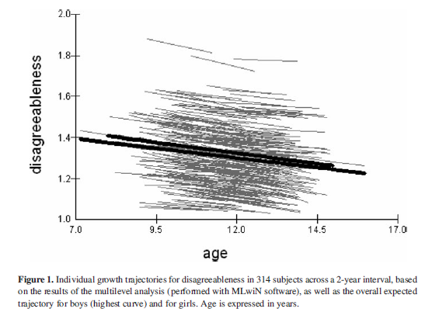
N = 477
m_{age} = 10.67 years
DIPSI
2 yr follow-up
DeClercq et al. (2009). D&P
Notes:
De Clerq, van Leeuwen, van den Noortgate, de Bolle and de Fruyt (7) assessed the maladaptive personality traits of 477 children (m_{age} = 10.67 years) using the Dimensional Personality Symptom Item Pool (DIPSI; 8), a dimensional measure of age-specific personality traits. Over a 1- and 2-year follow-up, levels of the maladaptive personality traits disagreeableness, emotional instability and compulsivity declined as the children entered early adolescence. However, this decline was less substantial in children who demonstrated high scores.

Slide 18
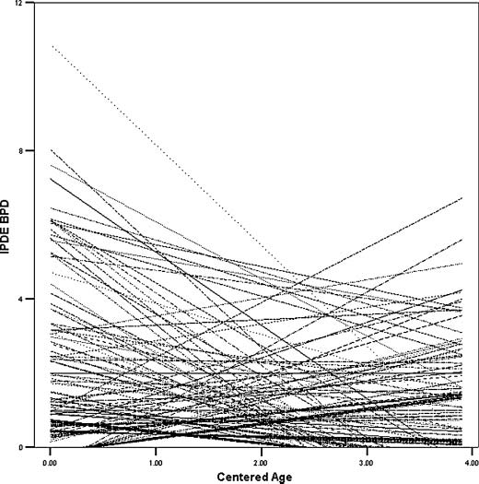
250 subjects (m_{initialage} = 18.88 years)
Follow-up: 4 years
Revised Interpersonal Adjectives Scale-Big 5
International Personality Disorder Examination
The development of adaptive personality traits
such as affiliation, conscientiousness and
openness, + decrease in neuroticism was associated with
a decrease in PD symptoms.
In contrast, as PD’s developed, the development of adaptive
personality traits ceased or even regressed.
Wright et al. (2010) JPA
Notes:
Over the course of 4 years, in a sample of 250 subjects (m_{initialage} = 18.88 years), Wright, Pincus and Lenzenweger (9) assessed the stability of PD features in late-adolescents and young adults. The International Personality Disorder Examination (IPDE; 10) assessed participant’s PD criteria at each of the studies 3 timepoints. The Revised Interpersonal Adjectives Scale-Big 5 (IASR-B5; 11) was included to measure the three personality factors (conscientiousness, neuroticism and openness) of the five-factor model (FFM) in each participant. Results indicate that the development of adaptive personality traits such as affiliation, conscientiousness and openness, as well as a decrease in neuroticism, is associated with a decrease in PD symptoms over time. In contrast, as PD’s developed, the development of adaptive personality traits ceased or even regressed.

Slide 19
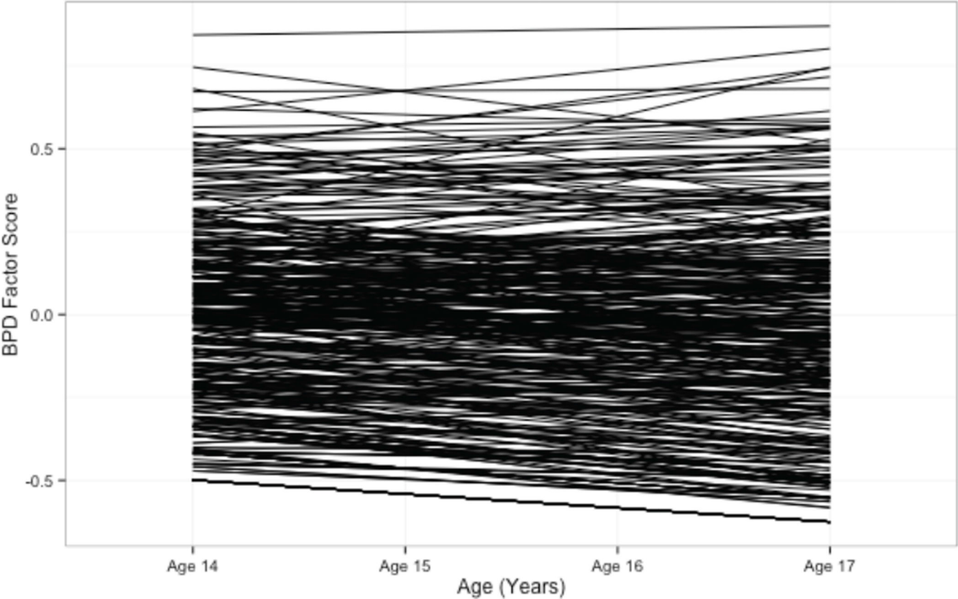
N = 2,450
age = 14-17 years
IPDE-BOR
2 yr follow-up
Wright et al. (2016) JPD
Notes:
Importantly, regardless of the degree of mean change, there was significant individual variability in initial value and rate of change across the study for all study variables. Thus, individuals started at different levels and changed at varying directions and rates across adolescence. In Figure 2 we provide a diagram of the observed heterogeneity in estimated BPD growth trajectories. As is readily seen, some individuals remained flat, consistent with the mean, whereas other increase and decrease dramatically.3 This type of rich heterogeneity in growth is a prerequisite for examining covariation in the developmental trajectories of BPD symptoms and psychosocial functioning.

Slide 20
Summary of studies of course
BPD onsets in adolescence.
General normative decline in personality pathology and an increase in adaptive personality traits, across adolescence, as youth enter young adulthood.
However, within these samples there also appears to be a subset of adolescents who diverge from the norm and whose personality pathology persists or increases into adulthood.
Therefore, while maladaptive traits are evident in pre-adolescence, they only begin to crystalize into disorder in adolescence.
The question then arises whether this subset of adolescents, whose pathology persists, meet threshold for a DSM defined (adult-like) personality disorder.

Slide 21
Five key findings
Finding #1:
BPD onsets in adolescents
Finding #2
Adolescent BPD by and large looks like adult BPD
Finding #3:
Personality pathology is as stable in adolescence as adulthood, but associated with poorer longterm outcomes
Finding #4:
Personality pathology is preceded by internalizing and externalizing disorders, but not the other way round
Finding #5:
Personality pathology remains comorbid with internalizing and externalizing pathology throughout development

Slide 22
Measure | Internal consistency | Inter-rater reliability | Factor structure | Construct validity
CI-BPD Zanarini (2003) | .81 | .65-.93 | Not reported
Sharp et al. (2012) | .80 | .89 | Unidimensional | Associates with PAI-BOR, clinician diagnosis, BPFS-C, BPFS-P, internalizing and externalizing problems
Michonski et al. (2013) | .78 | Not reported | Unidimensional | N/A
SWAP-A-II Westen et al. (2005) | Not reported | .60 | Not reported | r = .68 with DSM-5 symptom count AUC = .84
PAI-A BOR Morey (2007) | .85-.87 | N/A | Four-factor | Associated with range of other BPD relevant pathology
BPFS-C Crick et al. (2005) | .76 | N/A | Not reported | Associates with relational aggression, cognitive sensitivity, emotional sensitivity, friend exclusivity over time
Chang et al. (2011) | .88 | N/A | Not reported | Sensitivity .85 Specificity .84
BPFS-P Sharp et al. (2013) | .90 | N/A | Not reported | Correlates with BPFS-C, internalizing and externalizing problems
BPFC-11 Sharp et al. (2014) | .85 | N/A | Unidimensional | Sensitivity .740 Specificity .714

Slide 23
Measure | Internal consistency | Inter-rater reliability | Factor structure | External validity
MSI-BPD Chanen et al. (2008) | .78 | N/A | Not reported | Sensitivity .68 Specificity .75
BPQ Chanen et al. (2008) | .92 | N/A | Not reported | Sensitivity .68 Specificity .90
Minnesota BPD scale Bornavolova et al., 2009 | .81 | NA | Not reported | Correlates with PAI-BOR Mean difference for clinical vs. community sample
DIPSI DeClercq et al., 2006 | Not reported | NA | 27 facets ordered into 4-factor structure | Resembles factor structure of adult personality pathology; cross-sectional and prospectively predictive of key outcomes.
MMPI-adolescent version Archer, et al., 1995 | .43 (5) .90 (F) | NA | 14 factors (item level); 8 factors (scale level) | Good congruence between MMPI and MMI-A code types; minimal support for diagnostic BPD profile, but useful for differential diagnosis.
PID-5 DeClercq et al., 2012 | >.80 for 16 out of 25 facets | NA | 25 facets; 5 factor | Fair similarity between this and PID-5 factor structure observed in US adult sample as well as US and Flemish students; Correlates with DIPSI
Sharp & Fonagy (2015) JCPP

Slide 24
Some of our assessment work
CI-BPD
BPFSC
IRT study of 6,409 11-12 yr olds from the community (Michonski, Sharp et al., 2012)
  unidimensional
  good discrimination and difficulty
  measurement precision highest +1 to +3
  DIF at item level, but cancelled out at the level of the test
Construct validity in 190 12-17 yr old (Sharp et al., 2012):
  Unidimensional
  Convergent validity
Convergent validity in 171 13-18 yr olds from the community (Sharp et al., 2010)
  Parent-report version
Diagnostic utility in 51 psychiatric inpatients (Chang, Sharp & Ha, 2011)
IRT study of 1,042 community teens (Sharp et al., 2014)
  BPFSC-11
Fossati et al. (2016) Italian validation of the BPFSC

Slide 25
Prevalence rates
Clinical
  11% in outpatients (Chanen et al., 2004)
  33% (Ha et al., 2014) in inpatients
  43-49% (Levi et al., 1999) in inpatients
Epidemiological
  3% in the UK (Zanarini et al., 2011)
  1% in the USA (Lewinsohn et al., 1997)
  2% in China (Leung et al., 2009)
  cumulative prevalence rate of 3% (Johnson et al., 2008)

Slide 26
Meaning of criteria across developmental epochs
DIF: if individuals from different groups with the same underlying true ability have a different probability of giving a certain response

Slide 27
 | Adolescents | Young adults | Adults
N | 483 | 440 | 952
Age range | 12-17 | 18-25 | 26+
Mean age | 15.35 (SD = 1.44) | 21.34 (SD = 2.10) | 43.05 (SD = 12.55)
Gender | 62% female | 45.9% female | 50.8% female
Measure | CI-BPD | SCID | SCID
BPD | 33.8% | 28% | 14%
Sharp et al. (2018) Assessment

Slide 28
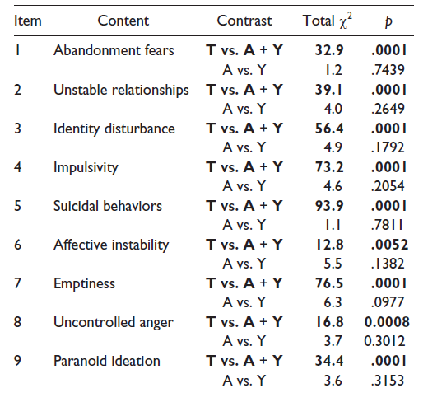
DIF: three group comparison
Sharp et al. (2018) Assessment

Slide 29
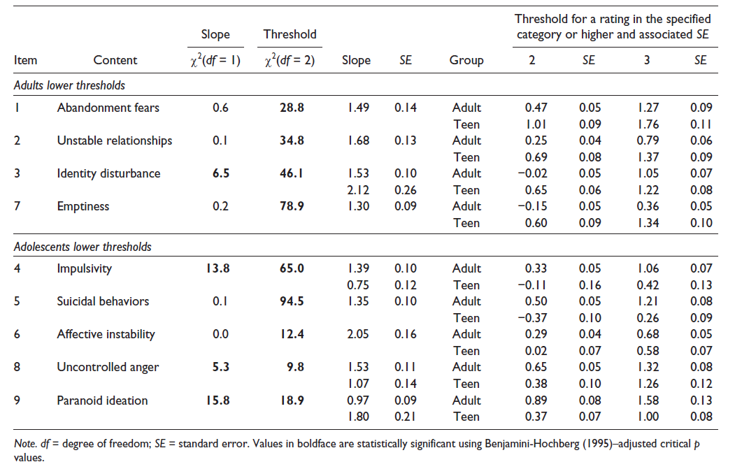

Slide 30
Verbatim responses
Emptiness
ID 6390 (age 14 years): Depressed is like tired and done, giving up. And empty is like, already kind of gone. I’m not really totally sure if I’m still there.
ID 5577 (age 17 years): No, ‘cause I know that my emptiness is ‘cause I’m trying to not feel what’s really there. So it’s almost like I’m trying to make myself empty.
Identity
ID 5317 (age 13 years): Kind of weird, like one moment, people call me somethin’, like, yeah that’s me. And then they’ll call me another thing and I’m like, I thought I was this but not this. Like . . . uh, it’s confusing.
ID 5507 (age 16 years): Like I never find something that defines me as me
Sharp et al. (2018) Assessment

Slide 31
Conclusions and implications
Criteria can be downwardly extended.
Adult-like BPD evident in adolescents.
Self-other (Criterion A) criteria discriminate better (stronger relation with latent trait) in adolescence than “behavioral” criteria possibly due to higher prevalence of behavioral criteria.
Normative patterns of behaviors should be taken into account when assessing BPD features to avoid overdiagnosis of “behavioral” criteria.
Knowledge about typical adolescence central to dissemination and training → developmental psychopathology approach.

Slide 32
PID-5-BF
Confirm purported factor structure of the PID-5 in both healthy and clinical samples
Evaluate the clinical utility of the PID 5 to predict personality pathology (as defined by Section II)

Slide 33
Methods
Participants
  142 healthy teens
  73 inpatient teens without BPD
  43 inpatient teens with BPD
Measures
  PID-5
  AIDA
  CI-BPD
  BPFSC, BPFSP
Analyses
  CFA
  ANOVA
  ROC analyses
  Regression

Slide 34
 | Neg. Affect | Disinhibition | Detachment | Antagonism | Psychoticism
10. Fear being alone in life more than anything else | .62 / .50
11. Get stuck on one way of doing things | .77 / .62
15. Get irritated easily | .60 / .44 | .37
8. I worry about almost everything | .69 / 1.00 | -.75
9. Get emotional easily for little reason | .74 / .89 | -.43
2. I act on impulse |  | .73 / .82
3. Can’t stop making rash decisions |  | .89 / .89
5. Others see me as irresponsible |  | .81 / .73
6. Not good at planning ahead |  | .65 / .54
1. People describe me as reckless |  | .61 / .82
13. Steer clear of romantic relationships |  |  | .51 / .28
4. Nothing I do really matters |  |  | .85 / .61
14. Not interested in making friends |  |  | .54 / .51
16. Don’t like to get too close to people |  |  | .50 / .74
18. Rarely get enthusiastic |  |  | .59 / .68
22. Use people to get what I want |  |  |  | .89 / .92
25. Easy to take advantage of others |  |  |  | .82 / .95
20. Have to deal with people who are less important |  |  |  | .79 / .66
17. No big deal if I hurt other peoples’ feelings |  |  |  | .78 / .74
19. I crave attention |  |  |  | .64 / .30
21. Thoughts that make sense to me…others say are strange |  |  |  |  | .76 / .77
7. Thoughts don’t make sense to others |  |  |  |  | .80 / .89
12. I have seen things that weren’t really there |  |  |  |  | .68 / .59
24. Things around me often feel unreal |  |  |  |  | .76 / .72
23. Often “zone out” |  |  |  |  | .69 / .58
Healthy
$$χ^{2}\left(265\right)=434.86, p<.01$$
$$RMSEA \text{0.068 [.056, .079] }$$
$$\text{CFI}\text{ = 0.922 }$$
$$\text{TLI}\text{ = 0.912 }$$
$$\text{SRMR}\text{ = 0.087}$$
Inpatient
$$χ^{2}\left(262\right)=397.76, p<.01$$
$$RMSEA\text{ 0.064}\text{ [.051, .077] }$$
$$\text{CFI}\text{ = 0.920 }$$
$$\text{TLI}\text{ = 0.908}$$
$$\text{SRMR}\text{ = 0.092}$$

Slide 35
 | Neg. Affect | Disinhibition | Detachment | Antagonism | Psychoticism
Neg. Affect
Disinhibition | .68** / .41*
Detachment | .54** / .16* | .53** / .05
Antagonism | .46** / .17 | .67** / .47** | .54** / .02
Psychoticism | .83** / .50** | .67** / .23** | .83** / .13* | .50** / .28**

Slide 36
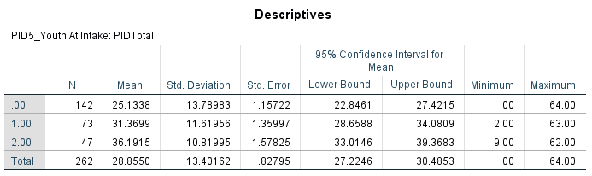
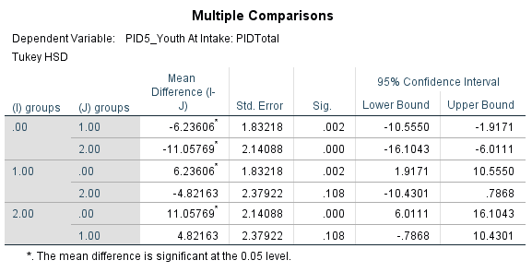
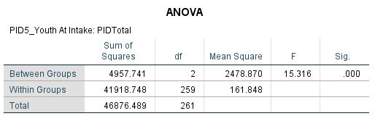
Clinical utility: group discrimination

Slide 37
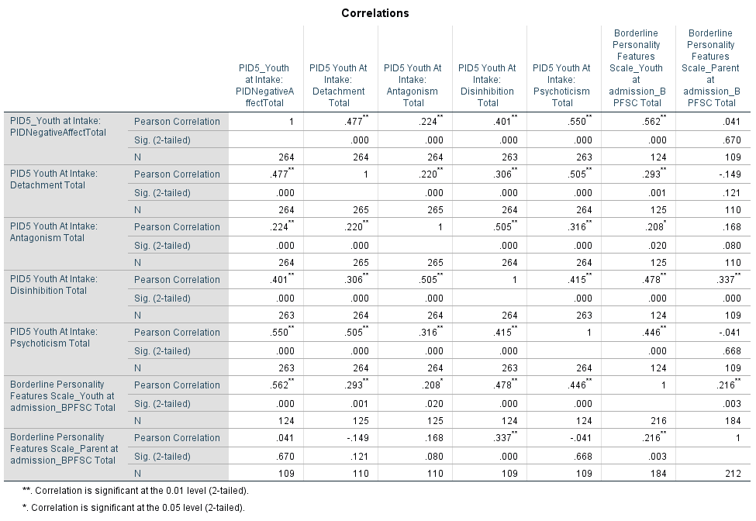

Slide 40
Clinical utility: diagnostic accuracy
BPD =
  Negative affectivity + Disinhibition + Antagonism (Fossati et al., 2016; Rojas & Widiger, 2016; Hopwood et al., 2012; APA)
  Negative affectivity + Disinhibition (Calvo et al., 2016)
  Negative affectivity + Disinhibition + Psychoticism (Bach & Selbom, 2016; Bastiaens, Smiths et al., 2016)
  Total score
.90-1 = excellent (A)
.80-.90 = good (B)
.70-.80 = fair (C)
.60-.70 = poor (D)
.50-.60 = fail (F)

Slide 41
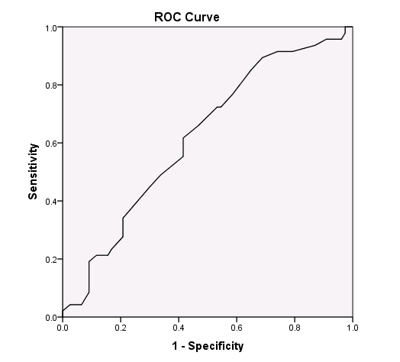
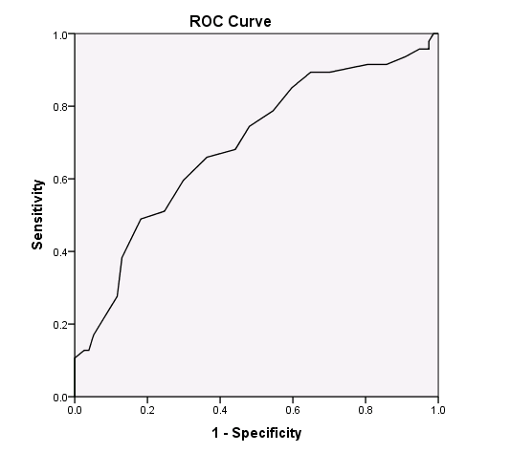
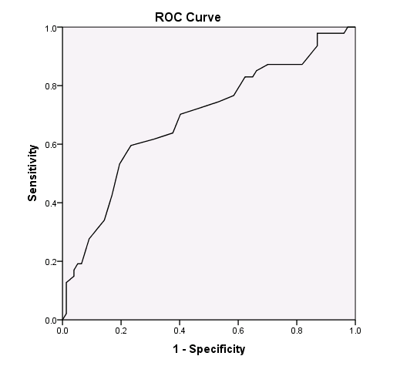
Clinical utility: diagnostic accuracy
Disinhibition, negative affectivity,
Antagonism
AUC = .62 (poor accuracy)
Negative affectivity, disinhibition
AUC = .69 (poor accuracy)
Negative affectivity, disinhibition,
psychoticism
AUC = .69 (poor accuracy)

Slide 42
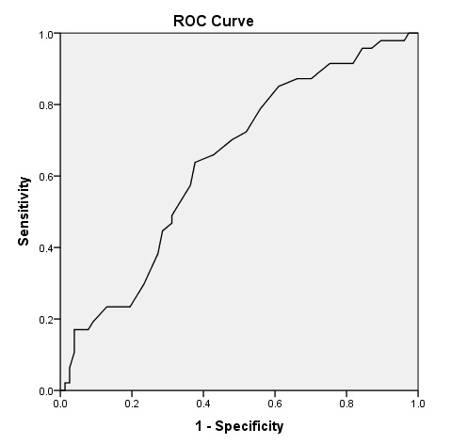
Clinical utility: diagnostic accuracy
Total score
AUC = .64 (low accuracy)

Slide 43
Five key findings
Finding #1:
BPD onsets in adolescents
Finding #2
Adolescent BPD by and large looks like adult BPD
Finding #3:
Personality pathology is as stable in adolescence as adulthood, but associated with poorer longterm outcomes
Finding #4:
Personality pathology is preceded by internalizing and externalizing disorders, but not the other way round
Finding #5:
Personality pathology remains comorbid with internalizing and externalizing pathology throughout development

Slide 44
Five key findings
Finding #1:
BPD onsets in adolescents
Finding #2
Adolescent BPD by and large looks like adult BPD
Finding #3:
Personality pathology is as stable in adolescence as adulthood, but associated with poorer longterm outcomes
Finding #4:
Personality pathology is preceded by internalizing and externalizing disorders, but not the other way round
Finding #5:
Personality pathology remains comorbid with internalizing and externalizing pathology throughout development

Slide 45
Rank-order stability for PD symptoms in the range of .40-.65
(Bornavola et al., 2013)

Slide 46
Rank-order stability for PD symptoms in the range of .40-.65
(Bornavola et al., 2013)

Slide 47
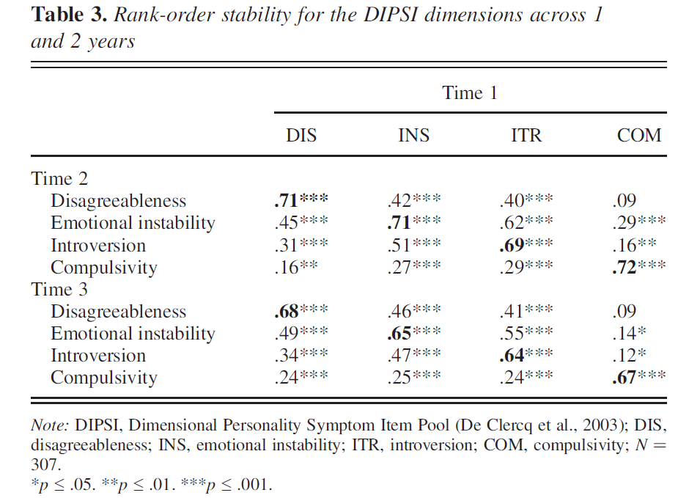
DeClercq et al. (2009). D&P

Slide 48
More rank-order stability studies
CIC
  .4-.7 (Cohen et al., 2005)
  Cluster B personality pathology (borderline, narcissistic and histrionic PD), over the course of 9 years: .63 for boys and .69 for girls.
Minnesota Twin Family Study rank-order stability of .53-.73 in adolescent female twins, assessed over a period of 10 years from ages 17-24 (Bornovalova, et al., 2009).
HYPE (Chanen et al., 2004), stability index of .54 over the course of 2 years in a sample of 101 adolescents, aged 15-18.
Similar to ranges reported for normal personality traits in both adults and children

Slide 49
Moderate, but more problematic
More stable than int/ext:
  CIC: Cluster B more stable than internalizing and externalizing.
  May be more enduring and long-lasting than internalizing and externalizing psychopathology, despite moderate stability.
  DeClercq et al (2009): Externalizing symptoms show steeper and continued decline beyond that of personality traits → developmental maturation processes/”grow out” of externalizing behaviors
Associated with more dysfunction:
  Wright et al (2016): N = 2,450

Slide 50
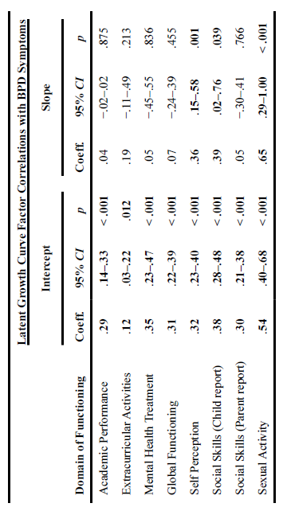
Wright et al. (2016) JPD

Slide 51
Criterion A
Wright et al. (2016) JPD

Slide 52
Incremental value of BPD
Sharp et al (2012)
156 consecutive admissions (55.1% female; age = 15.47; SD = 1.41).
A diagnosis of MDD or BPD independently increased the odds for thinking about death by nearly 2.5 times, MDD, B = −.91; SE = .36; Wald statistic (1) = 6.56; p = .01, OR = 2.48; BPD, B = −.88; SE = .44; Wald statistic (1) = 4.02; df = 1, p < .05, OR =2.42,
The addition of BPD to the model robustly improved correct classification of those wishing to die from 29% to 41%.
Being female similarly increased risk for thinking about death, B = −.86; SE = .36; Wald statistic (1) = 5.64; df = 1, p = .02, OR = 2.36.
Chanen et al (2006)
BPD significantly predicted general psychopathology as measured by the Youth Self-Report (YSR; Achenbach, 1991) and the Young Adult Self-Report (YASR; Achenbach, 1997), functioning, peer relationships, self-care, and family and relationship functioning, above and beyond other PD’s or Axis I disorders.

Slide 53
Five key findings
Finding #1:
BPD onsets in adolescents
Finding #2
Adolescent BPD by and large looks like adult BPD
Finding #3:
Personality pathology is as stable in adolescence as adulthood, but associated with poorer longterm outcomes
Finding #4:
Personality pathology is preceded by internalizing and externalizing disorders, but not the other way round
Finding #5:
Personality pathology remains comorbid with internalizing and externalizing pathology throughout development

Slide 54
Five key findings
Finding #1:
BPD onsets in adolescents
Finding #2
Adolescent BPD by and large looks like adult BPD
Finding #3:
Personality pathology is as stable in adolescence as adulthood, but associated with poorer longterm outcomes
Finding #4:
Personality pathology is preceded by internalizing and externalizing disorders, but not the other way round
Finding #5:
Personality pathology remains comorbid with internalizing and externalizing pathology throughout development

Slide 55
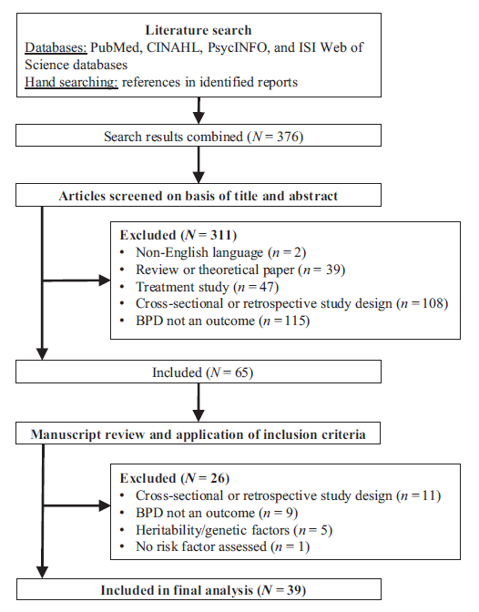
Half examine internalizing and externalizing as predictor of subsequent BPD
Belsky et al. (2012)
  Traits at age 12 more common in those with EBD at age 5
Bornovalova et al. (2013)
  Inherited vulnerability for int/ext → BPD
Krabbendam et al. (2015)
  PTSD, depr, diss → BPD
Stepp et al. (2013)
  SUD and internalizing
Burke & Stepp (2012)
Stepp et al. (2013)
  ADHD and ODD
Sharp et al. (2015)
  EA → borderline features
Rey et al. (1995)
  40% vs. 12% for ext vs. int disorders and later BPD features
Stepp et al. (2016) PD:TRT

Slide 56
Int/Ext *not* preceded by BPD
Lazarus et al., 2017 | Measured BPD and INT/EXT annually from age 14-17 (PGS) | Tested hypothesis whether BPD and SU are developmental precursors to each other; found that after accounting for cross-sectional relations and temporal stability of each construct, BPD is not a causal antecedent for SU
Bornovalova, Hicks, Iacono, & McGue, 2013 | BPD & Substance Use measured at age 14 and 18; Used a cross-lagged model to examine whether BPD (age 14) had a causal effect on SU (age 18) and vice versa | Tested hypothesis whether BPD and SU are developmental precursors to each other; found that after accounting for cross-sectional relations and temporal stability of each construct, BPD is not a causal antecedent

Slide 57
Five key findings
Finding #1:
BPD onsets in adolescents
Finding #2
Adolescent BPD by and large looks like adult BPD
Finding #3:
Personality pathology is as stable in adolescence as adulthood, but associated with poorer longterm outcomes
Finding #4:
Personality pathology is preceded by internalizing and externalizing disorders, but not the other way round
Finding #5:
Personality pathology remains comorbid with internalizing and externalizing pathology throughout development

Slide 58
Five key findings
Finding #1:
BPD onsets in adolescents
Finding #2
Adolescent BPD by and large looks like adult BPD
Finding #3:
Personality pathology is as stable in adolescence as adulthood, but associated with poorer longterm outcomes
Finding #4:
Personality pathology is preceded by internalizing and externalizing disorders, but not the other way round
Finding #5:
Personality pathology remains comorbid with internalizing and externalizing pathology throughout development

Slide 59
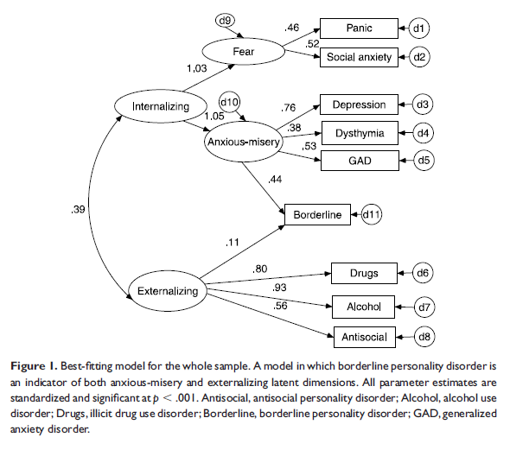
James & Taylor (2008)

Slide 60
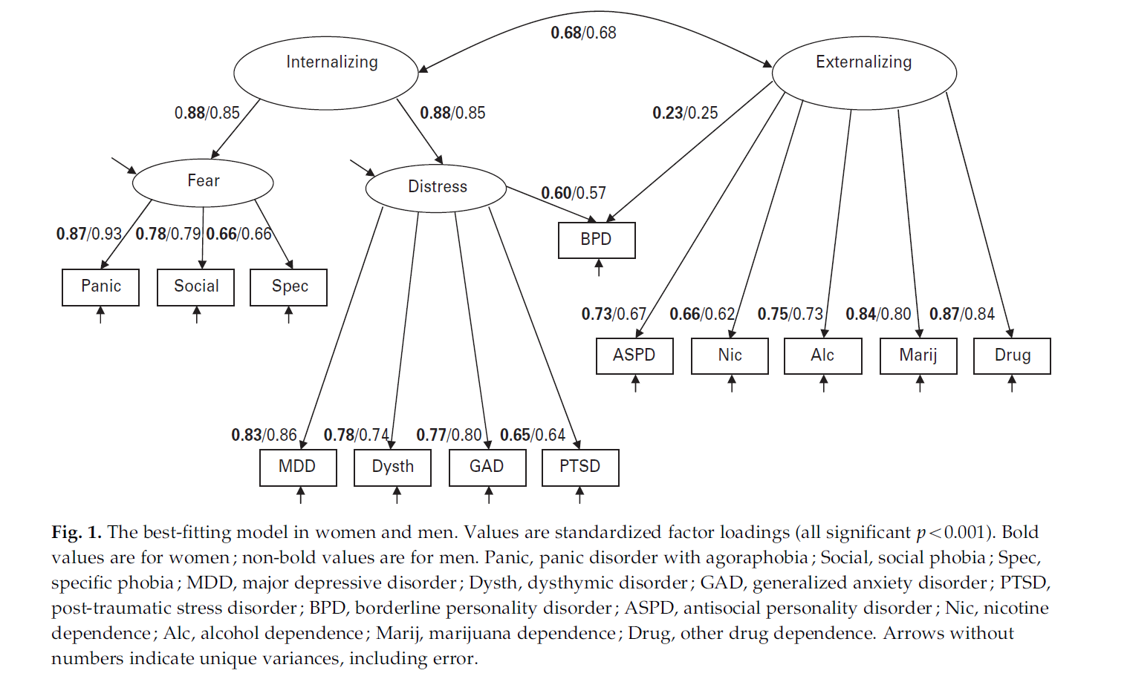
Eaton et al. (2011)

Slide 61
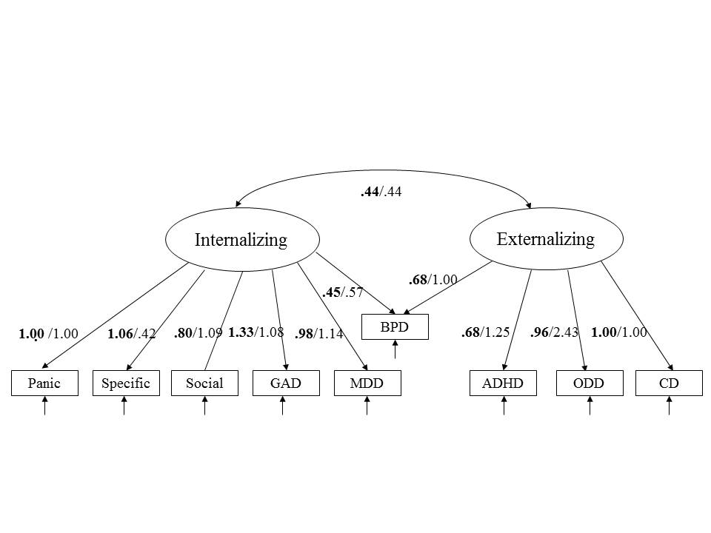
Sharp et al. (in prep)

Slide 62
Summary of 5 key findings
Maladaptive traits are observable in pre-adolescence, and while some adolescents adhere to the normative decline in personality pathology through adolescence and early adulthood, a proportion of adolescents’ symptoms increase or stagnate. These are the adolescents who may meet clinical threshold for personality disorder categorically defined and leads us to conclude that BPD onsets in adolescence.
Personality pathology, like adult personality pathology is moderately stable, and more stable than internalizing and externalizing pathology. Even when DSM-defined personality disorder remits, maladaptive self-perception and social function (Criterion A dysfunction) may persist.
Such maladaptive function in self-other relatedness appears to be specific to personality pathology and independent of internalizing and externalizing pathology.
Internalizing and externalizing pathology are antecedents of personality pathology and are subsumed in personality pathology as adolescents with high levels of personality pathology mature, such that high levels of comorbidity and shared risk factors are maintained throughout development.

Slide 63
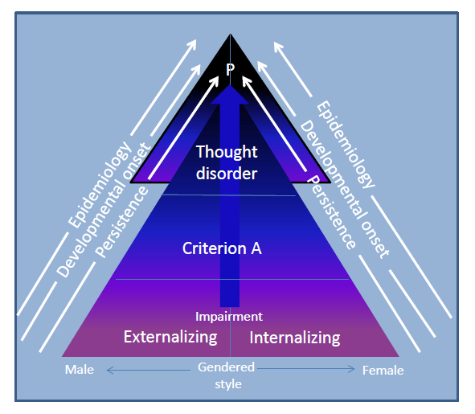
Sharp & Wall (2017)

Slide 64
Maladaptive self-and other relatedness
Sharp & Wall (2017)

Slide 65
Maladaptive self-and other relatedness
Adolescence
Sharp & Wall (2017)

Slide 66
“Adolescere”: "to ripen" or "to grow up“ -- SELF
Identity development a key developmental task.
Agentic, self-determining author of the self emerges in adolescence.
Pre-adolescence: organization and structure of self constrained by cognitive development.
The move from self-concept (pre-adolescence) to identity (adolescence) necessitates meaning making of self-concepts – integration of autobiographical past with imagined future in a coherent way.
Sharp, Vanwoerden & Wall (in press). PCNA

Slide 67
“Adolescere”: "to ripen" or "to grow up“ -- OTHER
Social reorientation
Social awareness and concern about others’ perspectives (“imaginary audience”)
Shared reflection with peers.
Shared reflection with parents.
Multiple self-hypotheses.
Late adolescence: integration.
Sharp, Vanwoerden & Wall (in press). PCNA

Slide 68
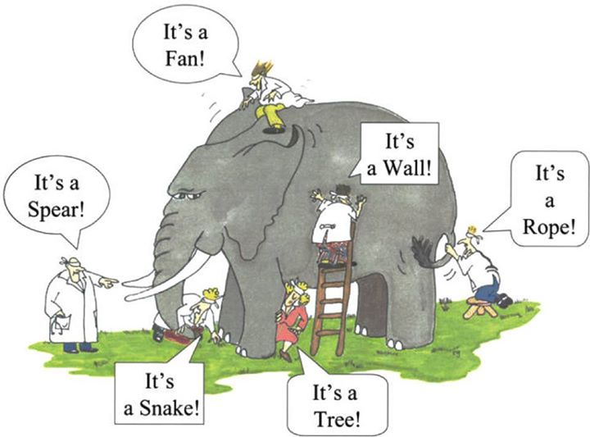

Slide 70
The developmental lens
The process of building one’s personality does not come on line in a mature form until adolescence.
Even though the structure of personality is observable in pre-adolescence.

Slide 71
The developmental lens
The process of building one’s personality does not come on line in a mature form until adolescence.
  > Criterion A
Even though the structure of personality is observable in pre-adolescence.
  > Criterion B

Slide 72
Maladaptive self-and other relatedness
Adolescence
Sharp & Wall (2017)

Slide 73
Maladaptive self-and other relatedness
Criterion A
Sharp & Wall (2017)

Slide 74
Maladaptive self-and other relatedness
Criterion A
Criterion B
Sharp & Wall (2017)

Slide 75
Therefore:
1) Criterion A is necessary (and perhaps sufficient?) to diagnose BPD
2) Criterion B is descriptive, and perhaps not necessary?

Slide 76
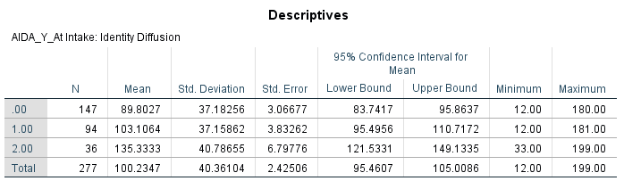
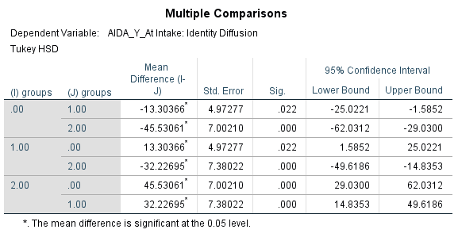
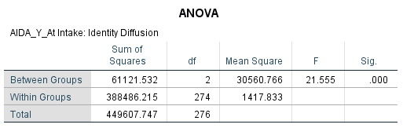
AIDA group comparisons

Slide 77
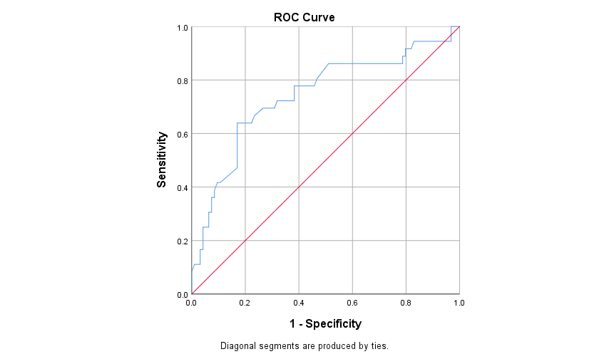
AIDA ROC curve
AUC = .76 (fair)

Slide 78
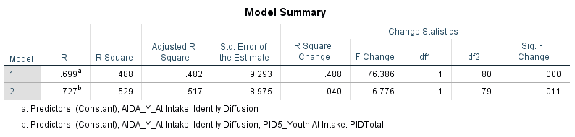
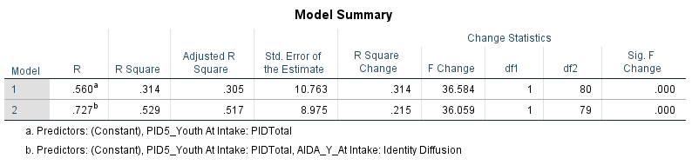
Relative value of Criterion B and Criterion A

Slide 79
What should we target in adolescence?

Slide 80
What should we target in adolescence?
Criterion A

Slide 81
Why should we care?
Intervention during this sensitive period can scaffold integrative meaning-making of traits

Slide 82
Criterion A
Maladaptive self and interpersonal function
Negative affectivity
Detachment
Antagonism
Disinhibition
Psychoticism

Slide 83
Many thanks!
csharp2@uh.edu

Slide 84

Acknowledgements
1R01HD081985, National Institute of Child Health and Development
American Psychological Foundation
Grand Challenges Explorations Grant, Bill & Melinda Gates Foundation
R 34 11644058, NIAAA
R21MH099351, NIMH
McNair Family Foundation
American Psychoanalytic Association
R43 HD077964-01, NIMH
F31 MH100865-01, NIMH
F31 MH100827, NIMH
University of Houston Grants to Enhance and Advance Research (GEAR)
University of Houston Small Grants Program
R01 MH078757, NIMH
National Alliance for Research on Schizophrenia and Depression (NARSAD)
RFP-AHRQ-08-10015, AHRQ

