Slide 1
The Alternative Model for DSM-5 Personality Disorders
Congress Zorgstandaard Personality Disorders
Workshop
Harlaam, The Netherlands
November 26, 2018
John M. Oldham, MD
Interim Chief of Staff, The Menninger Clinic
Distinguished Emeritus Professor of Psychiatry
Baylor College of Medicine,
Past President, American Psychiatric Association
Editor, Journal of Personality Disorders, and Borderline Personality Disorder and Emotion Dysregulation

Slide 2
Disclosure Statement
The speaker has no conflicts to disclose other
than potential shared revenue from sales of the
SCID-5-AMPD

Slide 3
Dimensional vs. Categorical
  Dimensional
  continuous, along a spectrum
  e.g., height or weight
  Categorical
  points of discontinuity
  features shared by a distinct group
  e.g., males, females, pregnant women

Slide 4
Examples of Dimensional Systems
  Interpersonal Circumplex - Leary, Wiggins, Kiesler
  Three factors - Eysenck & Eysenck
  Four factors - Livesley
  Five factors - Costa & McCrae
  Seven factors - Cloninger

Slide 5
The Three-Factor Model
  Neuroticism / Negative Emotionality
  Extraversion / Positive Emotionality
  Disinhibition vs. Constraint
  Eysenck & Eysenck

Slide 6
Four Factor Model
Different Methods of
Measurement
1. Self-report measures
of traits
2. Structured interviews
to assess DSM criteria
Different Samples
1. Clinical and non-clinical
2. Cultures:
Canada, Japan, China,
Spain, Holland,
Germany
Emotional
dysregulation/
anxious-
dependent
Dissocial/
psychopathic
Socially
withdrawn/
inhibited
Compulsive
Borderline PD
Antisocial PD
Schizoid/Avoidant
PD
Obsessive
Compulsive PD
- John Livesley

Slide 7
The Five-Factor Model of Personality
Neuroticism
Calm – Worrying
Even-tempered – Temperamental
Self-satisfied – Self-pitying
Comfortable – Self-conscious
Unemotional – Emotional
Hardy – Vulnerable
Extroversion
Reserved – Affectionate
Loner – Joiner
Quiet – Talkative
Passive – Active
Sober – Fun-loving
Unfeeling – Passionate
Openness to Experience
Down-to-earth – Imaginative
Uncreative – Creative
Conventional – Original
Prefer routine – Prefer variety
Uncurious – Curious
Conservative – Liberal
Agreeableness
Ruthless – Soft-hearted
Suspicious – Trusting
Stingy – Generous
Antagonistic – Acquiescent
Critical – Lenient
Irritable – Good-natured
Conscientiousness
Negligent – Conscientious
Lazy – Hardworking
Disorganized – Well-organized
Late – Punctual
Aimless – Ambitious
Quitting – Persevering
Adapted from Costa & McCrae 1986

Slide 8
Cloninger’s Seven-Factor Model
1. Temperament Domains (Moderately heritable, not greatly influenced by family environment)
  Novelty Seeking
  Harm Avoidance
  Reward Dependence
  Persistence
2. Character Domains (Moderately influenced by family environment, only weakly heritable)
  Self-transcendence
  Cooperativeness
  Self-directedness

Slide 9
Example of Categorical System

Slide 10
DSM-IV-TR Personality Disorders
(A “dimensionally-flavored” categorical system)
A. Cluster A (odd/eccentric)
  1. Paranoid
  2. Schizoid
  3. Schizotypal
  B. Cluster B (dramatic/emotional/impulsive)
  1. Antisocial
  2. Borderline
  3. Histrionic
  4. Narcissistic
  C. Cluster C (anxious/fearful)
  1. Avoidant
  2. Dependent
  3. Obsessive-Compulsive
D. Personality Disorder Not Otherwise Specified

Slide 11
Current Alternative Model for DSM-5 Personality Disorders (AMPD)
(Section III)

Slide 12
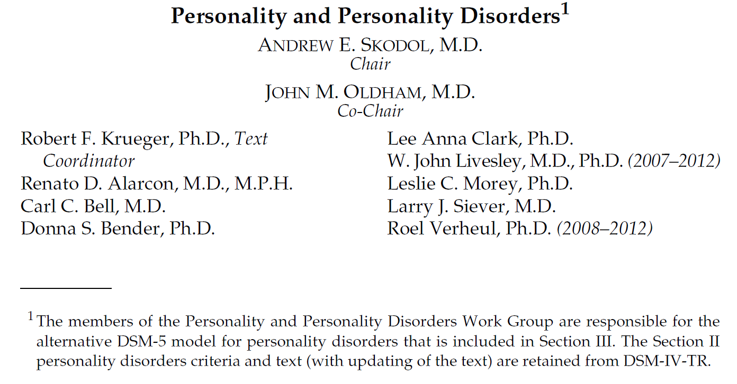

Slide 13
Draft 1 PD Model Posted February 2010
Prototype and trait model
Draft 2 PD Model Posted May 2011
Prototype model not accepted by Task Force
Changed from prototype to hybrid type/trait model
Draft 3 PD Model Posted May 2012
Minor modifications

Slide 14
Elements of Personality Functioning
1. Self
  a. Identity
  b. Self-direction
2. Interpersonal
  a. Empathy
  b. Intimacy

Slide 15
Elements of Optimal Personality Functioning
Self:
Identity: Experience of oneself as unique, with clear boundaries between self and others; stability of self-esteem and accuracy of self-appraisal; capacity for, and ability to regulate, a range of emotional experience.
Self-direction: Pursuit of coherent and meaningful short-term and life goals; utilization of constructive and prosocial internal standards of behavior; ability to self-reflect productively.
Interpersonal:
Empathy: Comprehension and appreciation of others’ experiences and motivations; tolerance of differing perspectives; understanding the effects of own behavior on others.
Intimacy: Depth and duration of connection with others; desire and capacity for closeness; mutuality of regard reflected in interpersonal behavior.
Reprinted with permission from the Diagnostic and Statistical Manual of Mental Disorders, Fifth Edition, (Copyright © 2013).
American Psychiatric Association. All rights reserved.

Slide 16
DSM-5 General Criteria for Personality Disorder (GCPD)
The essential features of Personality Disorder are:
Moderate or greater impairment in personality (self / interpersonal) functioning AND
One or more pathological personality traits

Slide 17
Criterion A:
(Level of Impairment in Personality Functioning)
Moderate or greater impairment in personality (self/interpersonal) functioning, manifest by characteristic difficulties in the following four areas:
Identity
Self-direction
Empathy
Intimacy
Reprinted with permission from the Diagnostic and Statistical Manual of Mental Disorders, Fifth Edition, (Copyright © 2013).
American Psychiatric Association. All rights reserved.

Slide 18
Guidance in estimating “moderate or greater impairment”:
Level of Personality Functioning Scale
0 - Little or No Impairment
1 - Some Impairment
2 - Moderate Impairment
3 - Severe Impairment
4 - Extreme Impairment

Slide 19
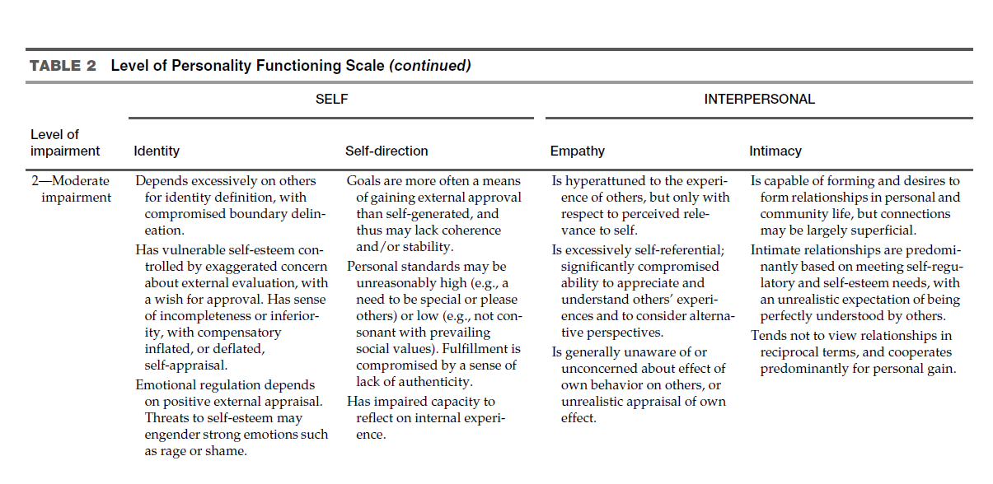

Slide 20
Criterion B:
(Patterns of Pathological Personality Traits)
  Trait Domains
  Negative Affectivity
  Detachment
  Antagonism
  Disinhibition
  Psychoticism

Slide 21
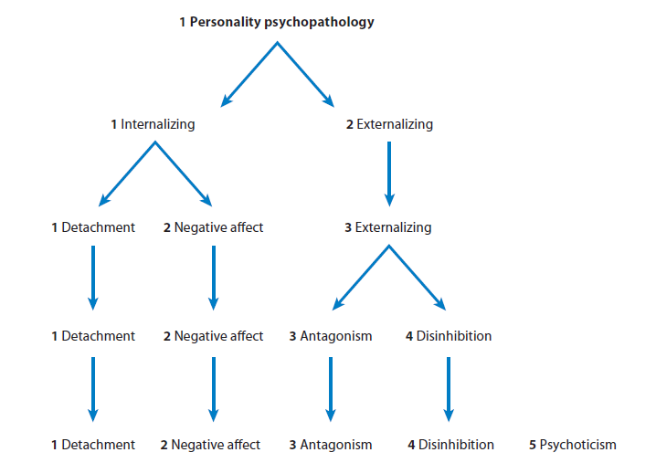
A Hierarchical Model of Personality Psychopathology
Krueger & Markon, Annu Rev Clin Psychol, 2014
Krueger & Markon, Annu Rev Clin Psychol, 2014

Slide 22
Negative Affectivity (vs. emotional stability)
  Emotional lability
  Anxiousness
  Separation insecurity
  Submissiveness
  Hostility
  Perseveration
  Depressivity
  Suspiciousness
  Restricted affectivity

Slide 23
Detachment (vs. extraversion)
  Withdrawal
  Intimacy avoidance
  Anhedonia
  Depressivity
  Restricted affectivity
  Suspiciousness

Slide 24
Antagonism (vs. agreeableness)
    Manipulativeness
    Deceitfulness
    Grandiosity
    Attention seeking
    Callousness
    Hostility

Slide 25
Disinhibition (vs. conscientiousness)
  Irresponsibility
  Impulsivity
  Distractibility
  Risk taking
  (lack of) Rigid perfectionism

Slide 26
Psychoticism (vs. lucidity)
1. Unusual beliefs and experiences
2. Eccentricity
3. Cognitive & perceptual dysregulation

Slide 27
Personality Disorders
  Antisocial
  Avoidant
  Borderline
  Narcissistic
  Obsessive-Compulsive
  Schizotypal
  PD – Trait Specified

Slide 28
Clinician Assessment of DSM-5 Personality Disorders
Moderate or Greater Impairment in Personality Functioning
Personality Disorder(s)
PD – Trait-Specified
or
Meets All Other General PD Criteria
PD Diagnosis Confirmed

Slide 29
Example
Borderline Personality Disorder

Slide 30
Borderline Personality Disorder (BPD)
APA DSM-5 Alternative Model (AM)
Typical features of Borderline Personality Disorder are instability of self-image, personal goals, interpersonal relationships, and affects, accompanied by impulsivity, risk-taking, and/or hostility. Characteristic difficulties are apparent in identity, self-direction, empathy, and/or intimacy, as described below, along with specific maladaptive traits in the domain of Negative Affectivity, and also Antagonism and/or Disinhibition.
Reprinted with permission from the Diagnostic and Statistical Manual of Mental Disorders, Fifth Edition, (Copyright © 2013)..
American Psychiatric Association. All rights reserved.

Slide 31
Borderline Personality Disorder
Criterion A (abbreviated):
Moderate or greater impairment in personality functioning in 2 or more of the following areas:
1. Identity: Marked instability of self-image, strong self-criticism, feelings of emptiness, stress-induced dissociative states
2. Self-direction: Unstable goals and values
3. Empathy: Limited ability to see things from another’s point of view, sensitivity to real or imagined criticism
4. Intimacy: Conflicted relationships, difficulty trusting others, separation insecurity, patterns of overinvolvement/withdrawal

Slide 32
Borderline Personality Disorder
Criterion B (abbreviated):
4 or more of the following pathological personality traits (requiring at least one of #5, #6, or #7)
Emotional Lability (a facet of Negative Affectivity)
Anxiousness (a facet of Negative Affectivity)
Separation Insecurity (a facet of Negative Affectivity)
Depressivity (a facet of Negative Affectivity)
Impulsivity (a facet of Disinhibition)
Risk-taking (a facet of Disinhibition)
Hostility (a facet of Antagonism)

Slide 33
BPD, Alternative Model, “Shorthand”
Moderate or greater impairment in personality functioning
Pathological personality traits in the domains of negative affectivity, disinhibition, and/or antagonism

Slide 34
Possible Domain Correlations
RDoC |  | DSM-5
Negative Valence Systems |  | Negative Affectivity
Cognitive Systems Cognitive Systems |  | Psychoticism
Systems for Social Processes |  | Detachment
Self / Interpersonal Functioning
Fowler et al., in press

Slide 35
DSM-5, Section III -- | -- ICD-11
Negative affectivity --- | -- Negative affectivity domain
Detachment ----------- | -- Detachment domain
Antagonism ----------- | -- Dissocial domain
Disinhibition ----------- | -- Disinhibited domain
Psychoticism ---------- | -- (Schizotypal disorder)
(Trait facets of -- restricted affectivity, rigid perfectionism, perseveration) | -- Anankastic domain
Adapted from Newton-Howes et al., Lancet, 2015

Slide 36
Questions and Discussion

Slide 37
BREAK

Slide 38
The Development of the Structured Clinical Interview for DSM-5 Alternative Model for Personality Disorders (SCID-5-AMPD)
Michael B. First, MD
Andrew E. Skodol, MD
Donna S. Bender, PhD
John M. Oldham, MD

Slide 39
What is the SCID-5-AMPD?
(American Psychiatric Association Publishing, 2018)
Semi-structured interview (modeled on the SCID) for assessing the three essential parts of the DSM-5 Alternative Model for PD:
  Level of personality functioning
  Pathological personality traits
  Six personality disorders defined according to criteria based on specific impairments in personality functioning and particular numbers and configurations of pathological personality traits.

Slide 40
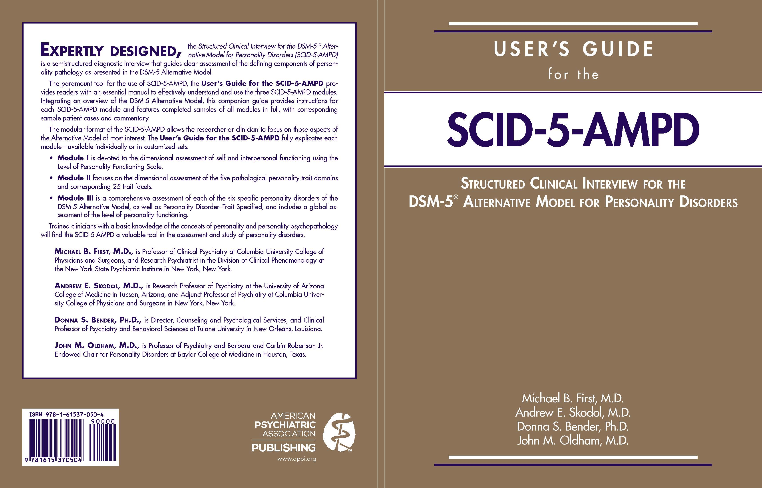

Slide 41
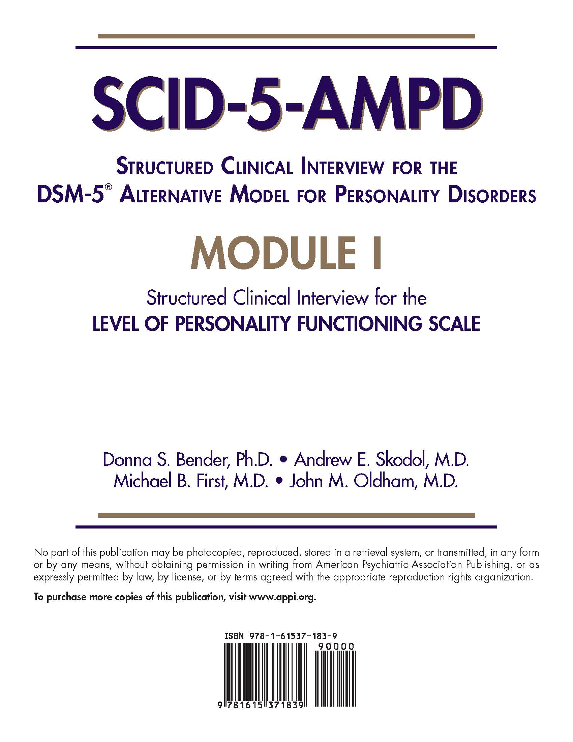

Slide 42
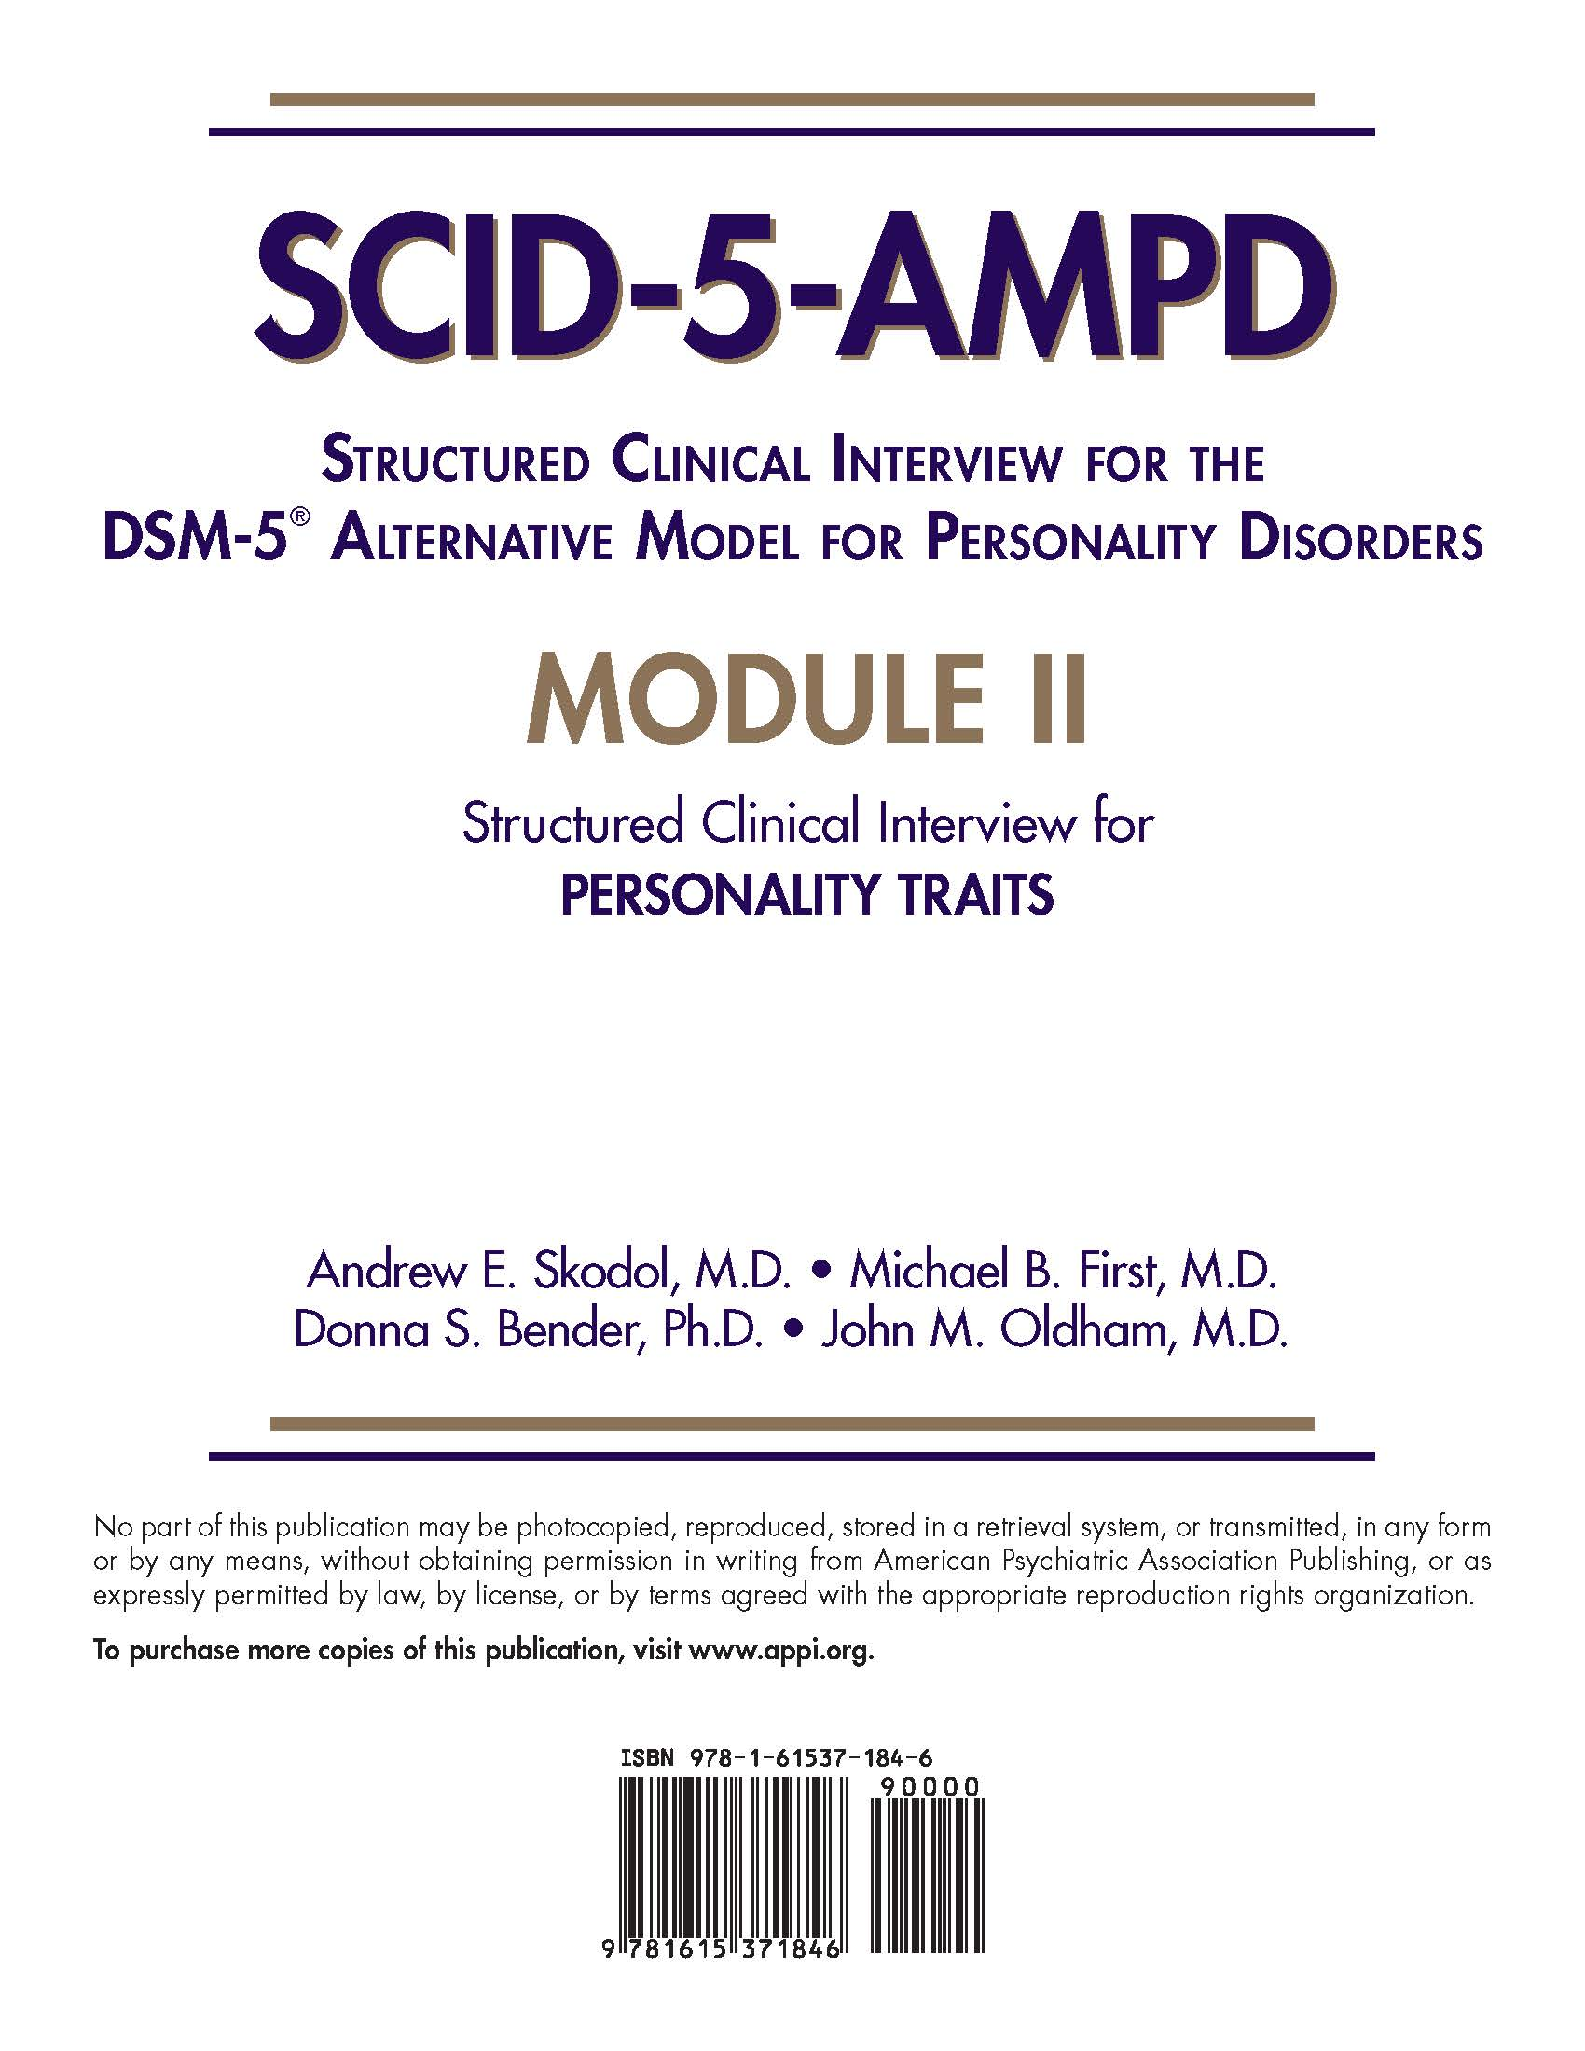

Slide 43
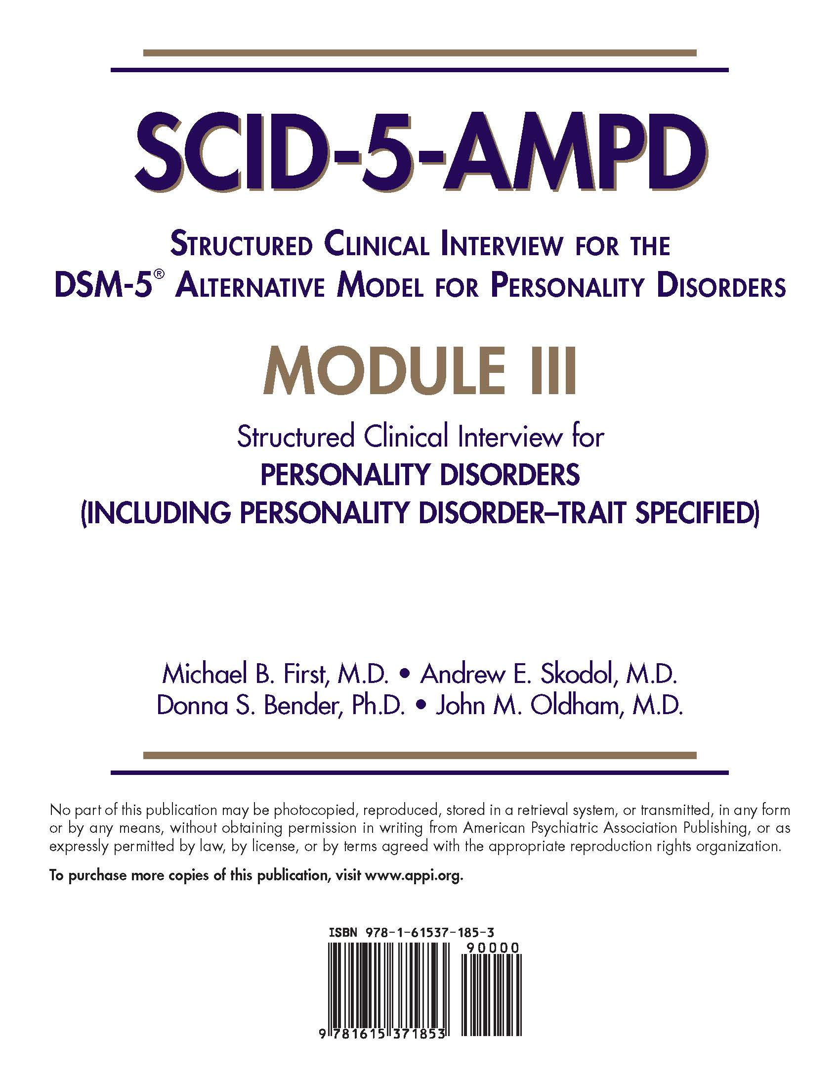

Slide 44
Module I: Level of Personality Functioning Scale
Module II: Personality Traits
Module III: Personality Disorders
(Including Personality Disorder-Trait Specified)

Slide 45
All Modules begin with two sets of questions:
General Overview for the SCID-5-AMPD
Preliminary Questions about View of Self and Quality of Interpersonal Relationships

Slide 46
Module I:
--Level of Functioning Scale, rated from 0 (Little or no impairment) to 4 (Extreme impairment)
--Evaluation of level of impairment in each of the four domains:
1. Identity
2. Self-Direction
3. Empathy
4. Intimacy

Slide 47
Module II:
--Evaluation for pathological personality traits, rated from 0 (Very little or not at all descriptive) to 3 (Very descriptive), plus ? (Insufficient information)
--Trait facets evaluated for each of the 5 domains:
1. Negative Affectivity
2. Detachment
3. Antagonism
4. Disinhibition
5. Psychoticism

Slide 48
Module III:
--Evaluation of Criterion A and Criterion B, using the same rating scales as Modules I and II, for each of the 6 specified Personality Disorders, plus PD-TS:
1. Avoidant
2. Obsessive-Compulsive
3. Narcissistic
4. Borderline
5. Antisocial
6. Schizotypal
7. Personality Disorder-Trait Specified

Slide 49
STRUCTURED CLINICAL INTERVIEW FOR THE DSM-5 ALTERNATIVE MODEL FOR PERSONALITY DISORDERS (SCID-AMPD)
MODULE III: Structured Clinical Interview for Personality Disorders (including Personality Disorder - Trait Specified)
Sample Patient Interview
John M. Oldham, M.D.
Baylor College of Medicine
Michael First, M.D
Columbia University College of Physicians & Surgeons
Andrew E. Skodol, M.D.
University of Arizona College of Medicine
Donna S. Bender, Ph.D.
Tulane University

Slide 50
Example of general introductory interview questions from the SCID-5-AMPD
(Selected sample questions and answers based on a de-identified real patient, referred to as Ms A)

Slide 51
Brief Summary Information about Ms A

Slide 52
General Overview For the SCID-AMPD
I’m going to start by asking you some questions about yourself and about problems or difficulties you may have had. I’ll be making some notes as we go along. Do you have any questions for me before we begin? No.
What kind of work do you do? Now I work as a librarian.
Have you always done that kind of work? This is my first job.
What’s the longest you’ve worked at one place? (seems nervous, avoids eye contact) This job. I didn’t know what to do when I finished college, but my parents got me my own apartment and supported me. Then I tried graduate school but I couldn’t take it. I got this job about 6 months ago.
Are you currently employed (getting paid)? Yes.
Has there ever been a period of time when you were unable to work or go to school? Well, when I dropped out of graduate school I wasn’t sure what to do.

Slide 53
Thinking back over your whole life, have there been times when things were not going well for you or when you were emotionally upset? (Tell me about that. When was that? What was that like? What was going on? How were you feeling?)
In college I did OK in my studies, but things got pretty upsetting a lot outside of class. I was never very comfortable around people; it was like they were judging me all the time and I didn’t think they liked me. So I’d stay by myself a lot, but then other times I’d just go along with whatever everybody else was doing. But I never felt clear about what I wanted to do.

Slide 54
PRELIMINARY QUESTIONS ABOUT VIEW OF SELF AND QUALITY OF INTERPERSONAL RELATIONSHIPS

Slide 55
The purpose of this interview is to explore different ways in which you see yourself, your basic approach to life, and how you interact with other people. Let’s start with some general questions about how you are as a person:
How would you describe yourself? I don’t really know. I don’t even have a very good idea what I’m interested in. In college I majored in liberal arts, but that was just because a lot of kids did that. I’d get interested in some school assignments or projects, but then I’d never stay with anything on my own.
How do you think other people describe you? I worry about that a lot. I don’t think people notice me much—I’m sort of on the sidelines. I don’t know how to know what’s in fashion, so I’m never sure how to dress for anything. And if people do seem friendly, I worry that it won’t last, since they wouldn’t like me for long but would just find me boring. I guess I’m pretty insecure. Sometimes I think some people kind of laugh at me or are critical of me, even if I haven’t done anything, and I don’t know how to sort it out.

Slide 56
3. How do you generally feel about yourself?
Lousy. I don’t have any self-confidence. My father is a big successful lawyer, and I know he’s disappointed in me. He gets annoyed and yells at me not to be a wimp, but I can’t be like him—I just can’t [gets tearful] . And my mother tries to help, but mostly she just likes to feel guilty about things—says it’s all her fault, and I don’t know what she means.
4. How successful would you say you are at getting the things you want in life? (Like having a satisfying relationship, a fulfilling career, close friends?)
Not very successful at all.

Slide 57
5. What are your relationships with other people like?
Like I said, not very good. My brother is a mess—he had a nervous breakdown and was put in the hospital. My sister’s OK—she’s older and married and has two kids and I don’t see her very much. In college I forced myself to go to parties and tried to meet people, but it usually ended up with me going off with some guy I hardly knew and we’d have sex and then that’d be it. I did have a boyfriend once, or I thought that’s what he was, but I wasn’t sure I could trust him or that he really cared about me. I got jealous and thought he was seeing other girl even though he wasn’t—I still don’t know. Finally, he said I was too possessive and he left. Then I got really depressed for a while.

Slide 58
6. Who are the most important people in your life?
I guess my parents are. I know they care about me, even though I feel so much pressure around them because I’m not succeeding like they want me to.
7. How well do you think you understand yourself?
Not very well at all.
8. How well do you understand other people?
Even worse! I can’t figure people out.

Slide 59
Ms K met criteria for 3 personality disorders:
1. Avoidant PD
2. Borderline PD
3. Schizotypal PD
What follows are selected questions and answers from the STPD section in
Module III

Slide 60
Schizotypal Personality Disorder
Typical features of schizotypal personality disorder are impairments in the capacity for social and close relationships and eccentricities in cognition, perception, and behavior that are associated with distorted self-image and incoherent personal goals and accompanied by suspiciousness and restricted emotional expression. Characteristic difficulties are apparent in identity, self-direction, empathy, and/or intimacy, along with specific maladaptive traits in the domains of Psychoticism and Detachment.

Slide 61
STPD Criterion A: Moderate or greater impairment in personality functioning, manifested by characteristic difficulties in two or more of the following four areas: 1. Identity 2. Self-Direction 3. Empathy 4. Intimacy
1. Identity: Confused boundaries between self and others; distorted self-concept; emotional expression often not congruent with context or internal experience.

Slide 62
Questions (re Identity)
Do you sometimes completely lose the sense of who you are when interacting with others? Yes.
Do you often take on the emotions and ideas of people you identify with? That happens a lot. Can you give me an example? If I like someone and want that person to like me, I’ll try to be like that person. Not just with guys either. A girl who I thought for a while was a friend was really into folk music which I knew nothing about, so I bought a lot of CDs and we’d listen to them together. But she could tell I was just trying to please her and wasn’t really interested.

Slide 63
Does being around other people sometimes make you feel confused about who you really are? Yes. Can you give me an example? Like the friend I just told you about. I even started to dress like her.
Are you very different from most people you know? I sometimes think so. IF YES: In what ways do you see yourself as different? I can get strange ideas or have odd experiences, such as feeling sort of detached from the world or getting suspicious. Once I became convinced that all of the canned food in my apartment was poisonous, and I threw it all out. I sort of knew that was crazy, but I couldn’t help it.

Slide 64
Have other people told you that your emotions seem disconnected with what’s going on, for example, laughing or acting silly when something really bad is happening? No, if I have weird thoughts, and I sometimes do, I usually keep them to myself.
RATING SCALES:
? = Insufficient information
0 = Absent
1 = Present but subthreshold
2 = Present at threshold

Slide 65
STPD Criterion A
Ratings for Ms A
1. Identity ? 0 1 2
2. Self-Direction: ? 0 1 2
3. Empathy: ? 0 1 2
4. Intimacy: ? 0 1 2

Slide 66
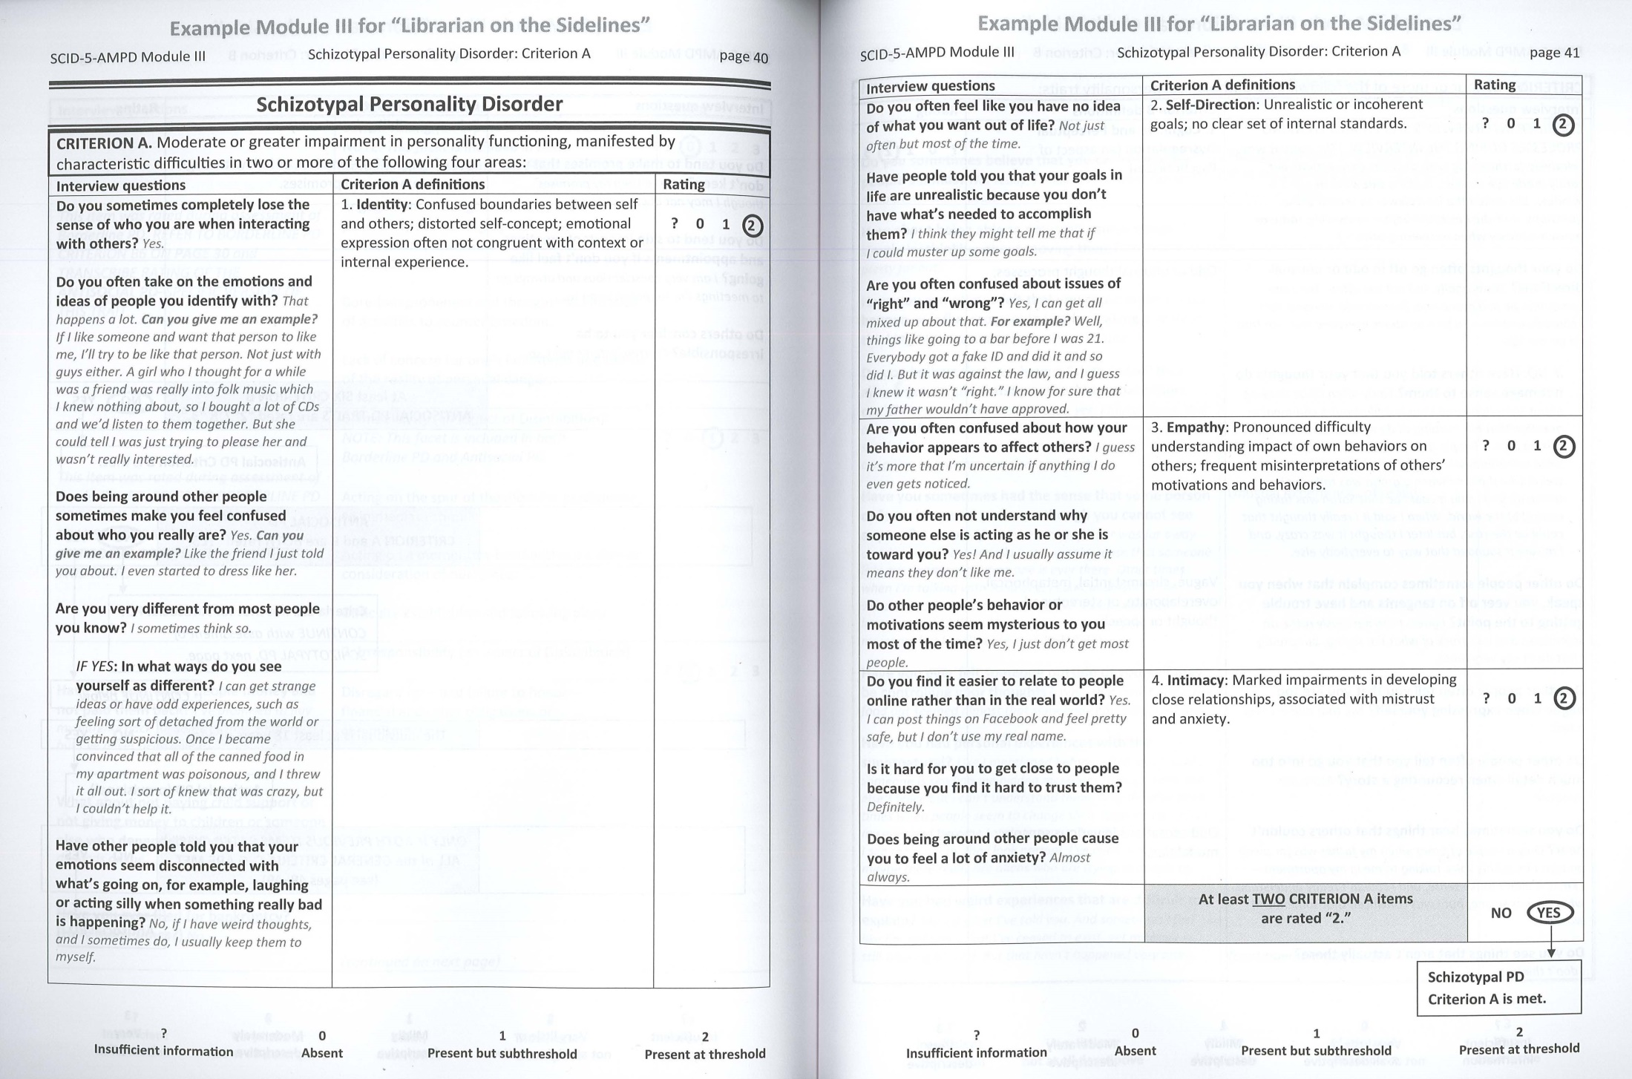

Slide 67
STPD Criterion B:
Four or more of the following six pathological personality traits: 1. Cognitive and perceptual dysregulation 2. Unusual beliefs and experiences 3. Eccentricity 4. Restricted affectivity 5. Withdrawal 6. Suspiciousness
Text--re #2 (Unusual beliefs and experiences):
2. Unusual beliefs and experiences: Thought content and views of reality that are viewed by others as bizarre or idiosyncratic. Unusual experiences of reality.
Questions--re #2 (Unusual beliefs and experiences):
Do you sometimes believe that you can read other people’s minds? Not really. I think some people can sort of do that; I wish I could.
How about being able to physically move things simply by thinking about moving them? No, that’s far out!

Slide 68
Have you sometimes felt that you could make things happen or influence people just by making a wish or thinking about them? No, but I wish I could.
Do you believe that you have a “sixth sense” that allows you to know and predict things that others can’t? I’ve sometimes thought that, yes. I had a dream that an aunt of mine was dying from cancer, and sure enough she did. And I have premonitions all the time that bad things are going to happen, and they usually do.
Have you sometimes had the sense that some person or force is around you even though you cannot see anyone? A couple of times when my father was away on trips. And occasionally just a spooky sense that someone is in my apartment but no one is ever there. Other times when I’m talking with someone, I can’t understand the words the other person is saying, like it’s an unknown language, and it feels like someone is sending me a message, but I can’t understand what it is.

Slide 69
Have you ever felt someone outside of yourself may be controlling your thoughts? Well, that time I threw the food out seemed almost that somebody had possessed me.
Have you had personal experiences with the supernatural? Like I mentioned before, when it seems like someone is sending me hidden messages through someone else’s voice, but I can’t understand them. Also there’ve been times when people seem to change their appearance before my eyes and become total strangers. But then later when I see them again, they look normal. I’ve even worried that maybe there really are aliens who are trying to invade us.

Slide 70
Have you had weird experiences that are difficult to explain? Mostly what I’ve told you. And sometimes I feel like I’m not real—that I’ve ceased to exist, yet my body is still walking around. But that hasn’t happened very often.
Have you had any other experiences that you or someone else might consider unusual? Well, I often have terrible dreams—like of violence, atomic bombs, prostitutes, murder, Nazis and spies, or that I’m dying. I don’t know where these come from, and it takes me a while when I’m waking up to realize that these are just dreams.

Slide 71
Trait Rating Scale for Criterion B:
? = Insufficient information
0 = Very little or not at all descriptive
1 = Mildly descriptive
2 = Moderately descriptive
3 = Very descriptive

Slide 72
STPD Ratings for Ms K
(At least 4 rated “2” or “3”)
Cognitive and Perceptual Dysregulation -- 2
Unusual Beliefs and Experiences -- 2
Eccentricity -- 1
Restricted Affectivity -- 0
Withdrawal -- 2
Suspiciousness -- 2

Slide 73
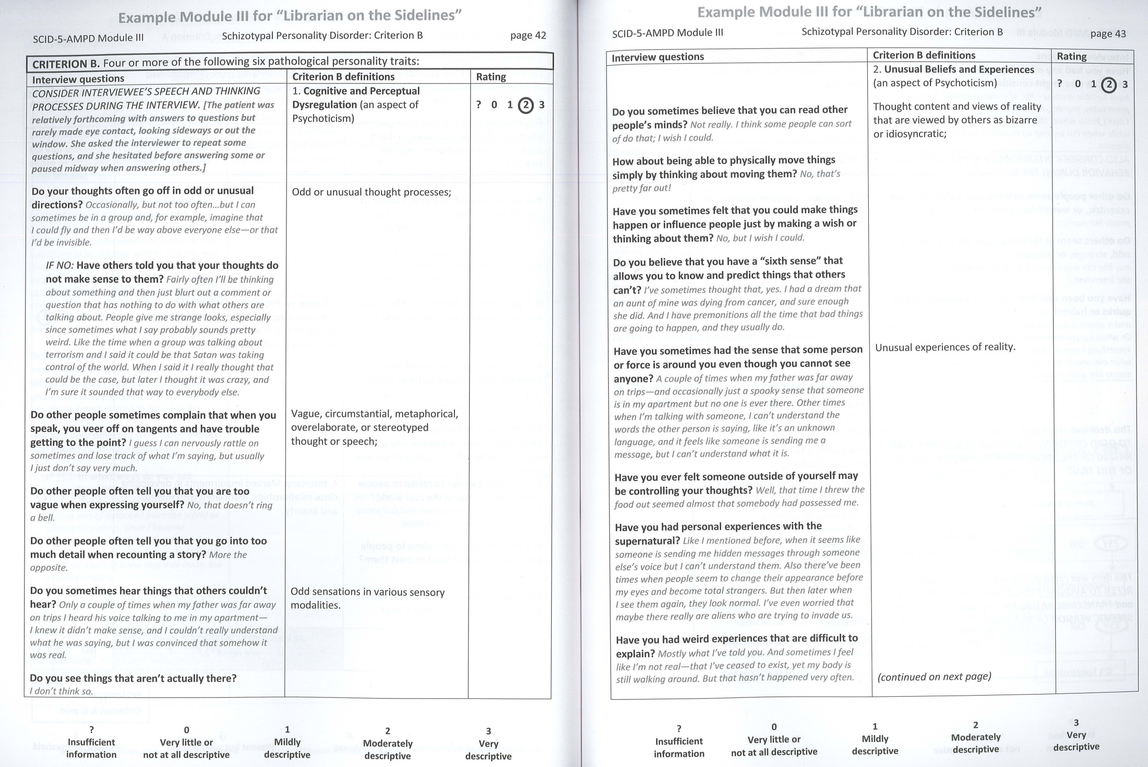

Slide 74
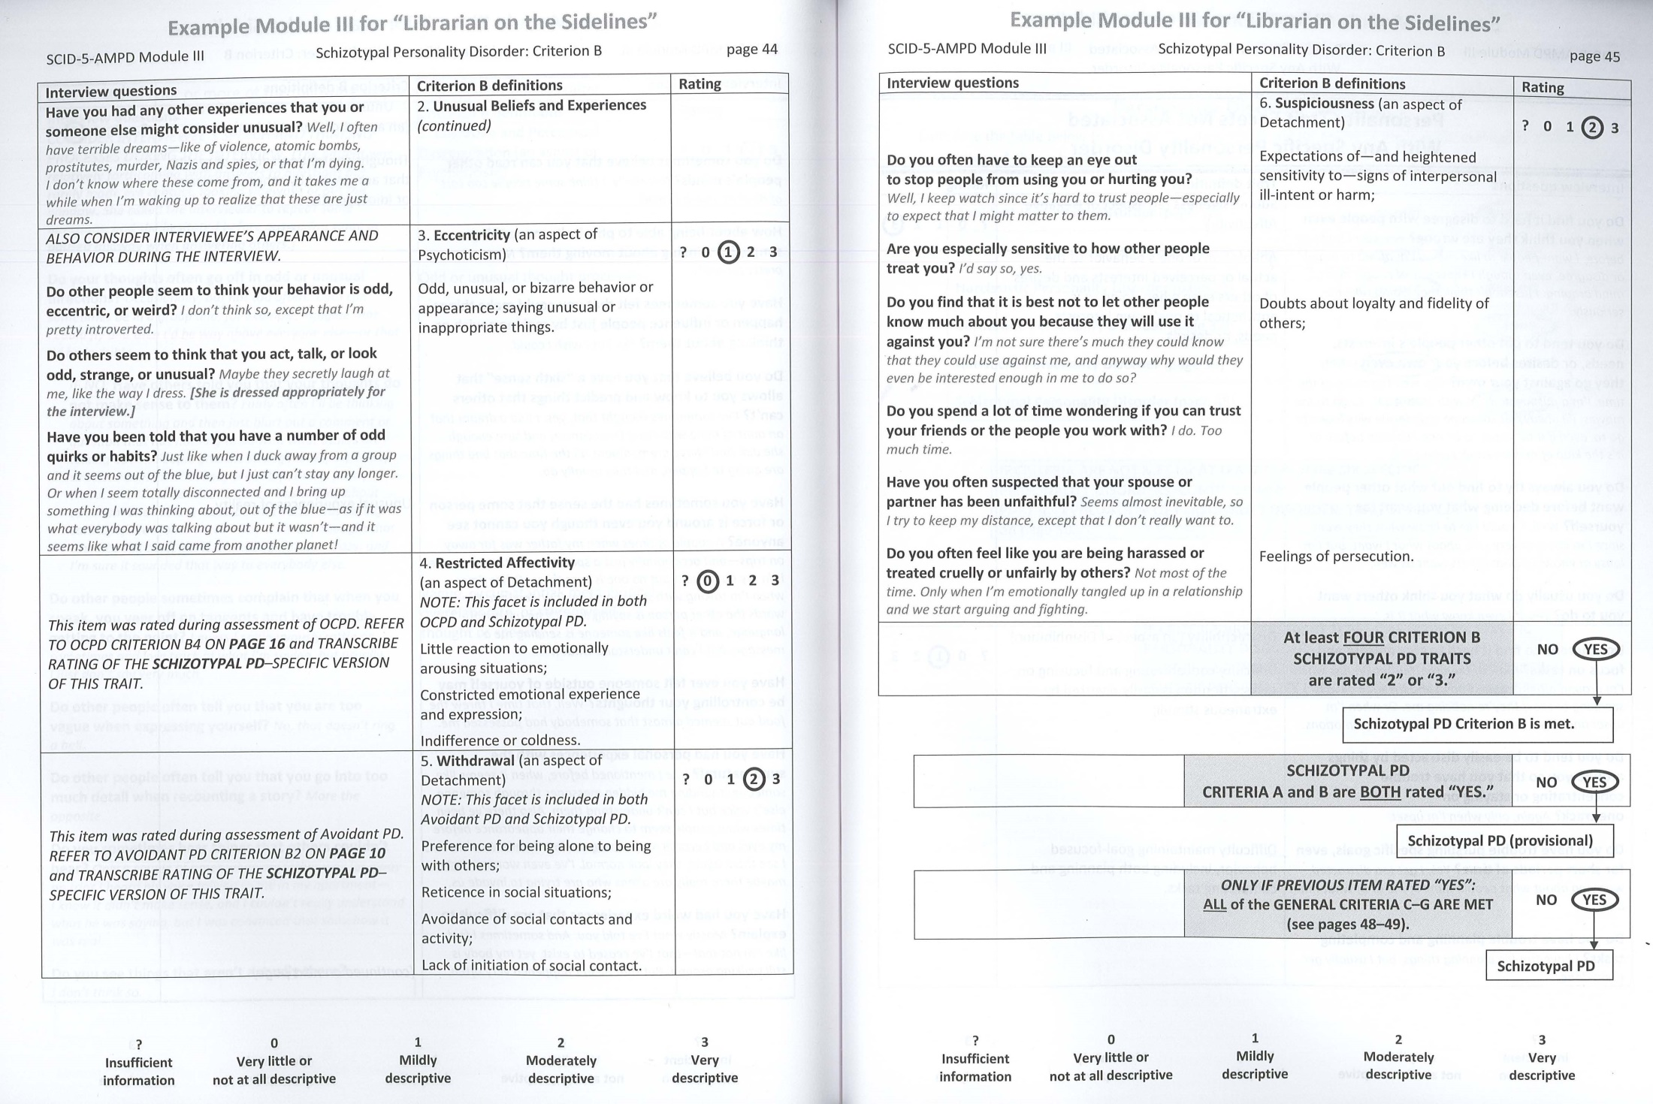

Slide 75
Results for Ms K
Antisocial Personality Disorder Absent
Present
_________________________________________________
Avoidant Personality Disorder Absent
Present
_________________________________________________
Borderline Personality Disorder Absent
Present
_________________________________________________
Narcissistic Personality Disorder Absent
Present
_________________________________________________
Obsessive Compulsive Personality Disorder Absent Present
_________________________________________________
Schizotypal Personality Disorder Absent
Present

Slide 76
Perhaps we need both categorical and dimensional models….

Slide 77
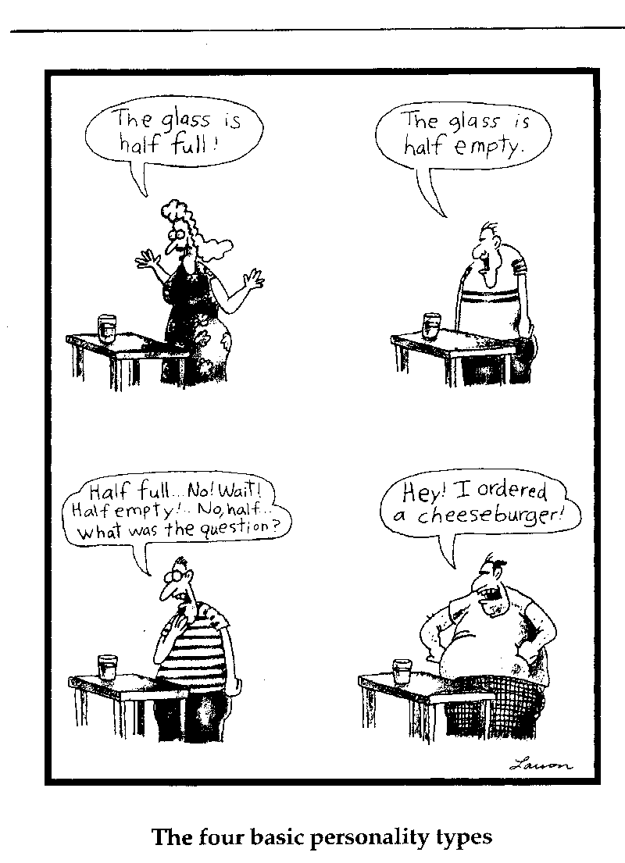
Categorical

Slide 78
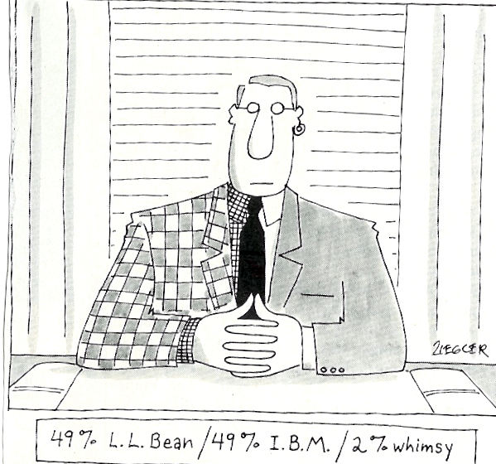
Dimensional

Slide 79
Thank you for your interest

